Slide 1

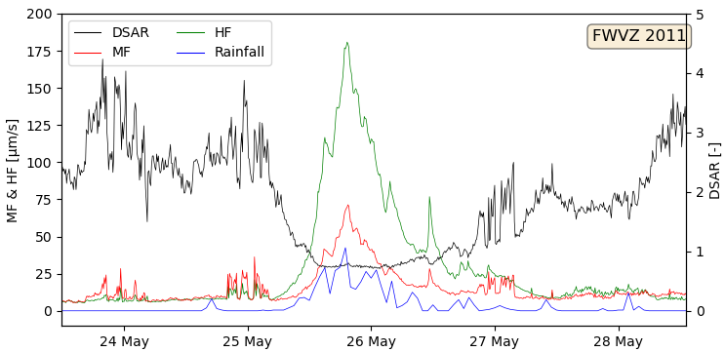
Ruapehu Eruption Forecasting: Classifying Anthropogenic and Weather Noise
Q. Gao and T. Waldin
Notes:
Will
Introduce ourselves
Briefly introduce our task

Slide 2
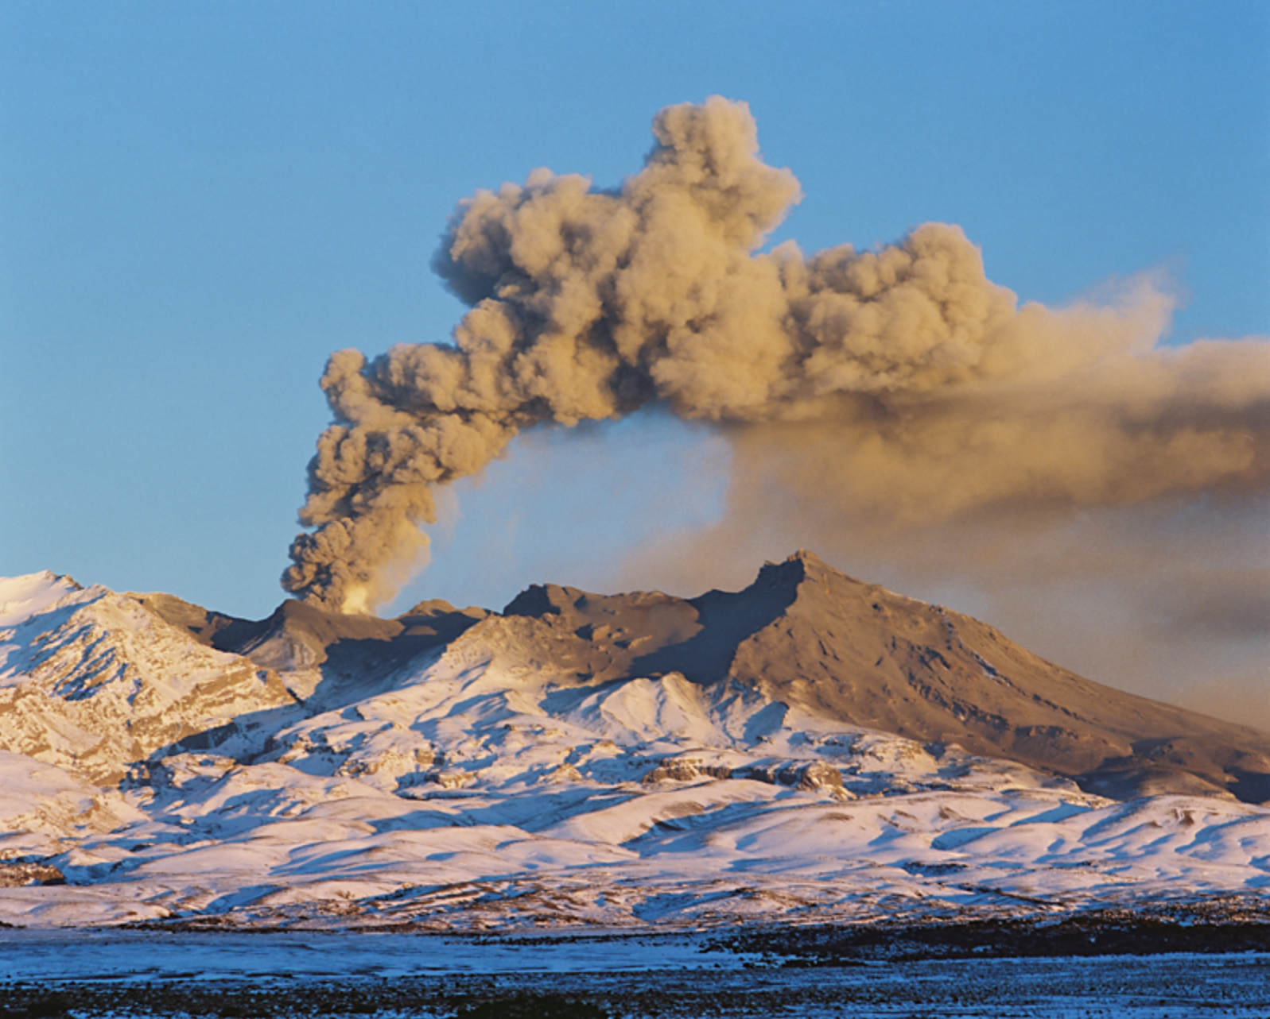
Mount Ruapehu has previously eruption 1995-1996, 2006 and 2007 causing injuries, and damaging infrastructure.
Notes:
Will
Rapid-onset phreatomagmatic eruptions – ash water rocks
Whakaari 2019, 22 deaths
Ruapehu several eruptions 1995-1996, 2006 and 2007.
Lahars

Slide 3
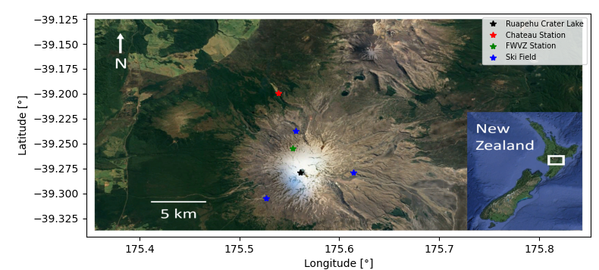
Mount Ruapehu is a popular tourist volcano in Tongariro National Park, North Island and has significant economic benefit to the local economy.
Notes:
Will
Located in Tongariro National Park, North Island, New Zealand
Used for tourism and recreation
Whakapapa and Turoa Ski fields capacity of 5500 each
Risk to people and economy.
FWVZ Station (green): monitoring the seismic signal.

Slide 4
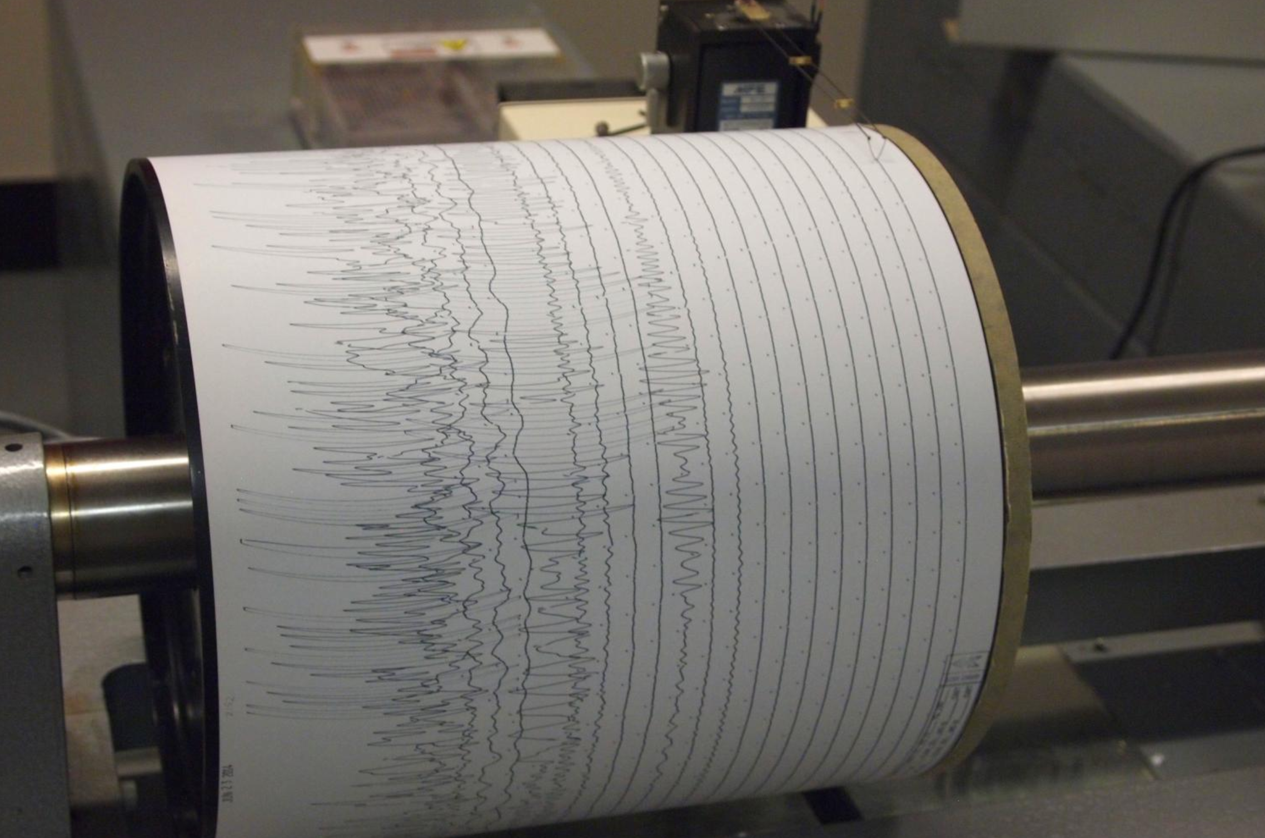
Volcanoes are monitored using Realtime Seismic Amplitude Measure (RSAM).
Notes:
Will
Data, 10mins periods (RSAM), relative intensity of vibrations in a particular frequency band.
Make sure to explain what it is (an averaged measure of noise being emitted by deep in the volcano)

Slide 5
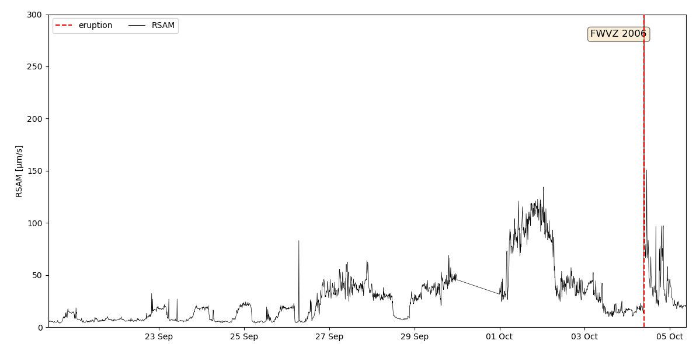
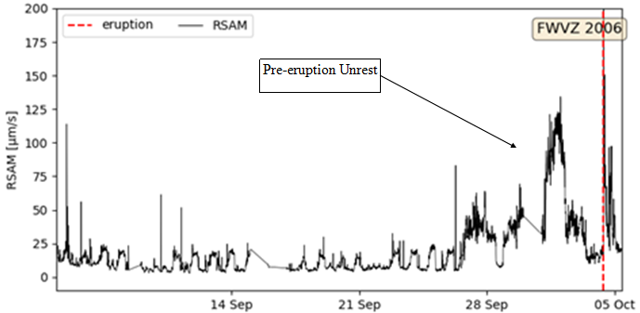
RSAM two weeks leading up to the 2006 Ruapehu eruption
Pre-eruptive unrest
Notes:
Tom
Signals can demonstrate volcanic unrest
Which can indicate an eruption about to occur
Describe plot

Slide 6
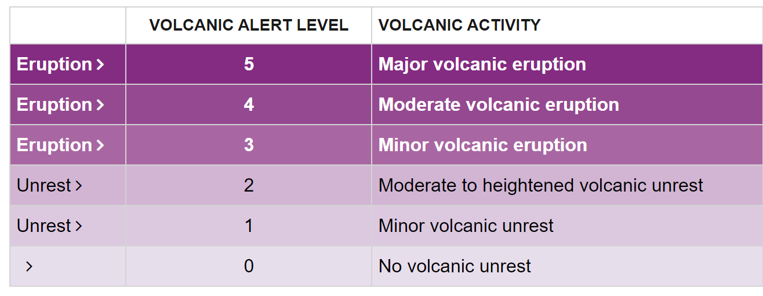
NZ currently uses Volcanic Alert Levels. A machine learning approach has been shown to produce a probability of eruption at Whakaari.
Notes:
Tom
NZ uses VAL – uses unrest to classify volcanic activity
Describe plot
Ruapehu 1, Whakaari 2
Ruapehu last at level 2 Dec 2020
Problems – no forecast of when or how likely
Machine learning approach developed at Whakaari – probability of eruption occuring

Slide 7
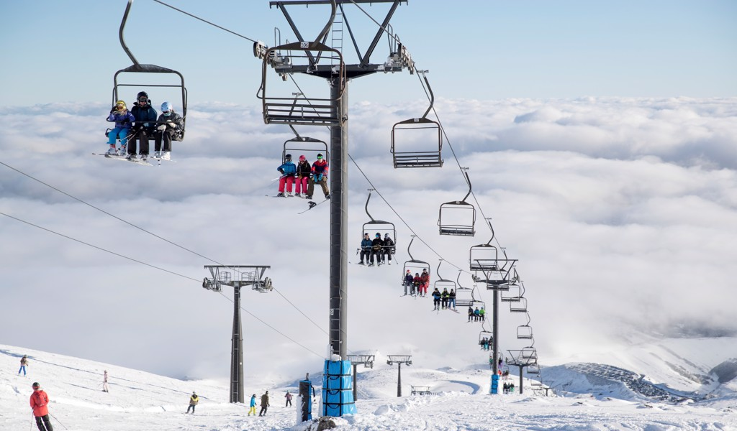
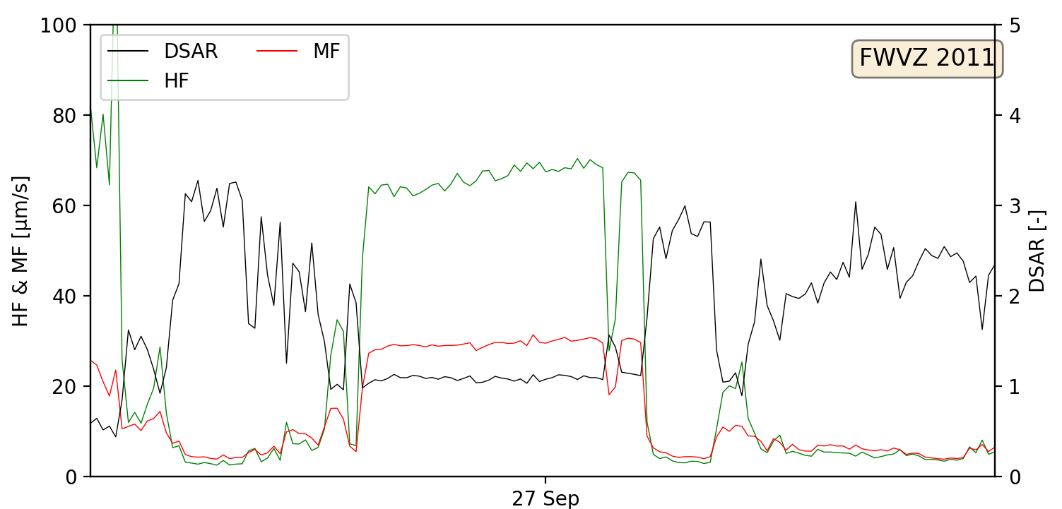
Chairlift Noise Contaminates RSAM
Notes:
Tom
Unlike Whakaari, chairlifts exist on Ruapehu
Contaminate signals, obscure precursor and confuse automated algorithm
HF MF DSAR Displacement Seismic Amplitude Ratio
Describe plot – uniform shape, periodic (8 hours, winter) plots in UTC

Slide 8
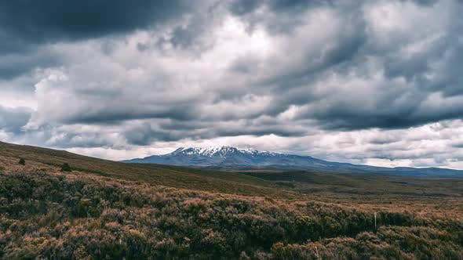
Storms Also Evident in Monitoring
Notes:
Tom
Ruapehu also experiences a greater frequency and intensity of storms than Whakaari
Describe plot – peak, rainfall included not periodic

Slide 9
The classification model was adapted from the model developed for Whakaari
Random Forest
Each decision tree evaluates a different combination of time-series features.
Models used 100 decision trees.
Decision Tree
Decision Tree
Decision Tree
Decision Tree
Decision Tree
Notes:
Tom
The classification model was adapted
The entire model was called a random forest, made up of smaller models called decision trees
Each decision tree evaluates … such as moving means or maximums and linear regressions.
Their output assesses whether combinations of features are associated with surface noise.
Our models used 100, more increase accuracy but also increase computation time.

Slide 10
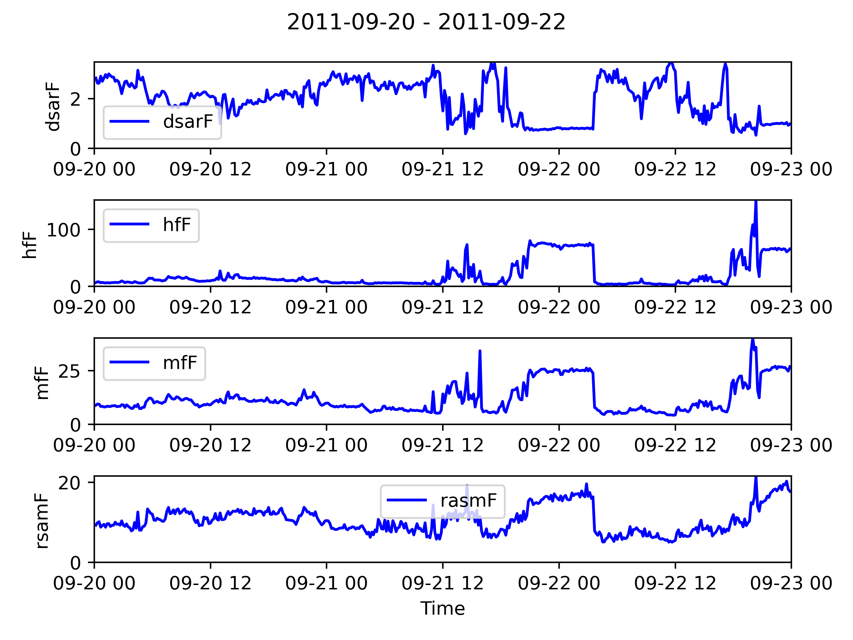
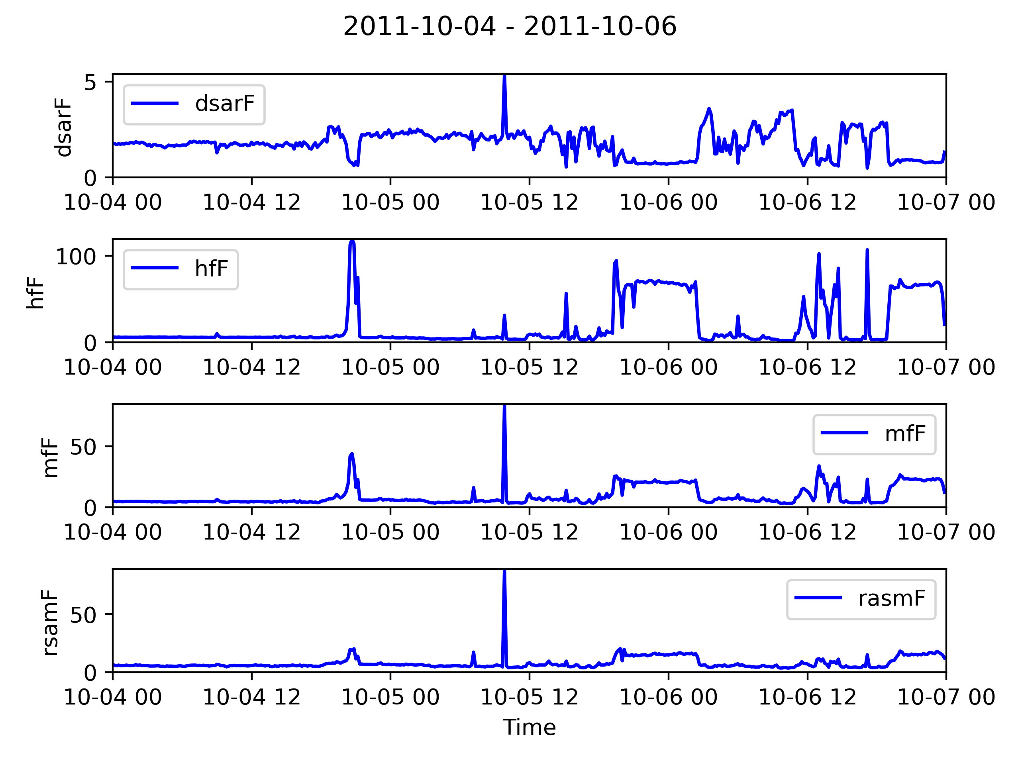
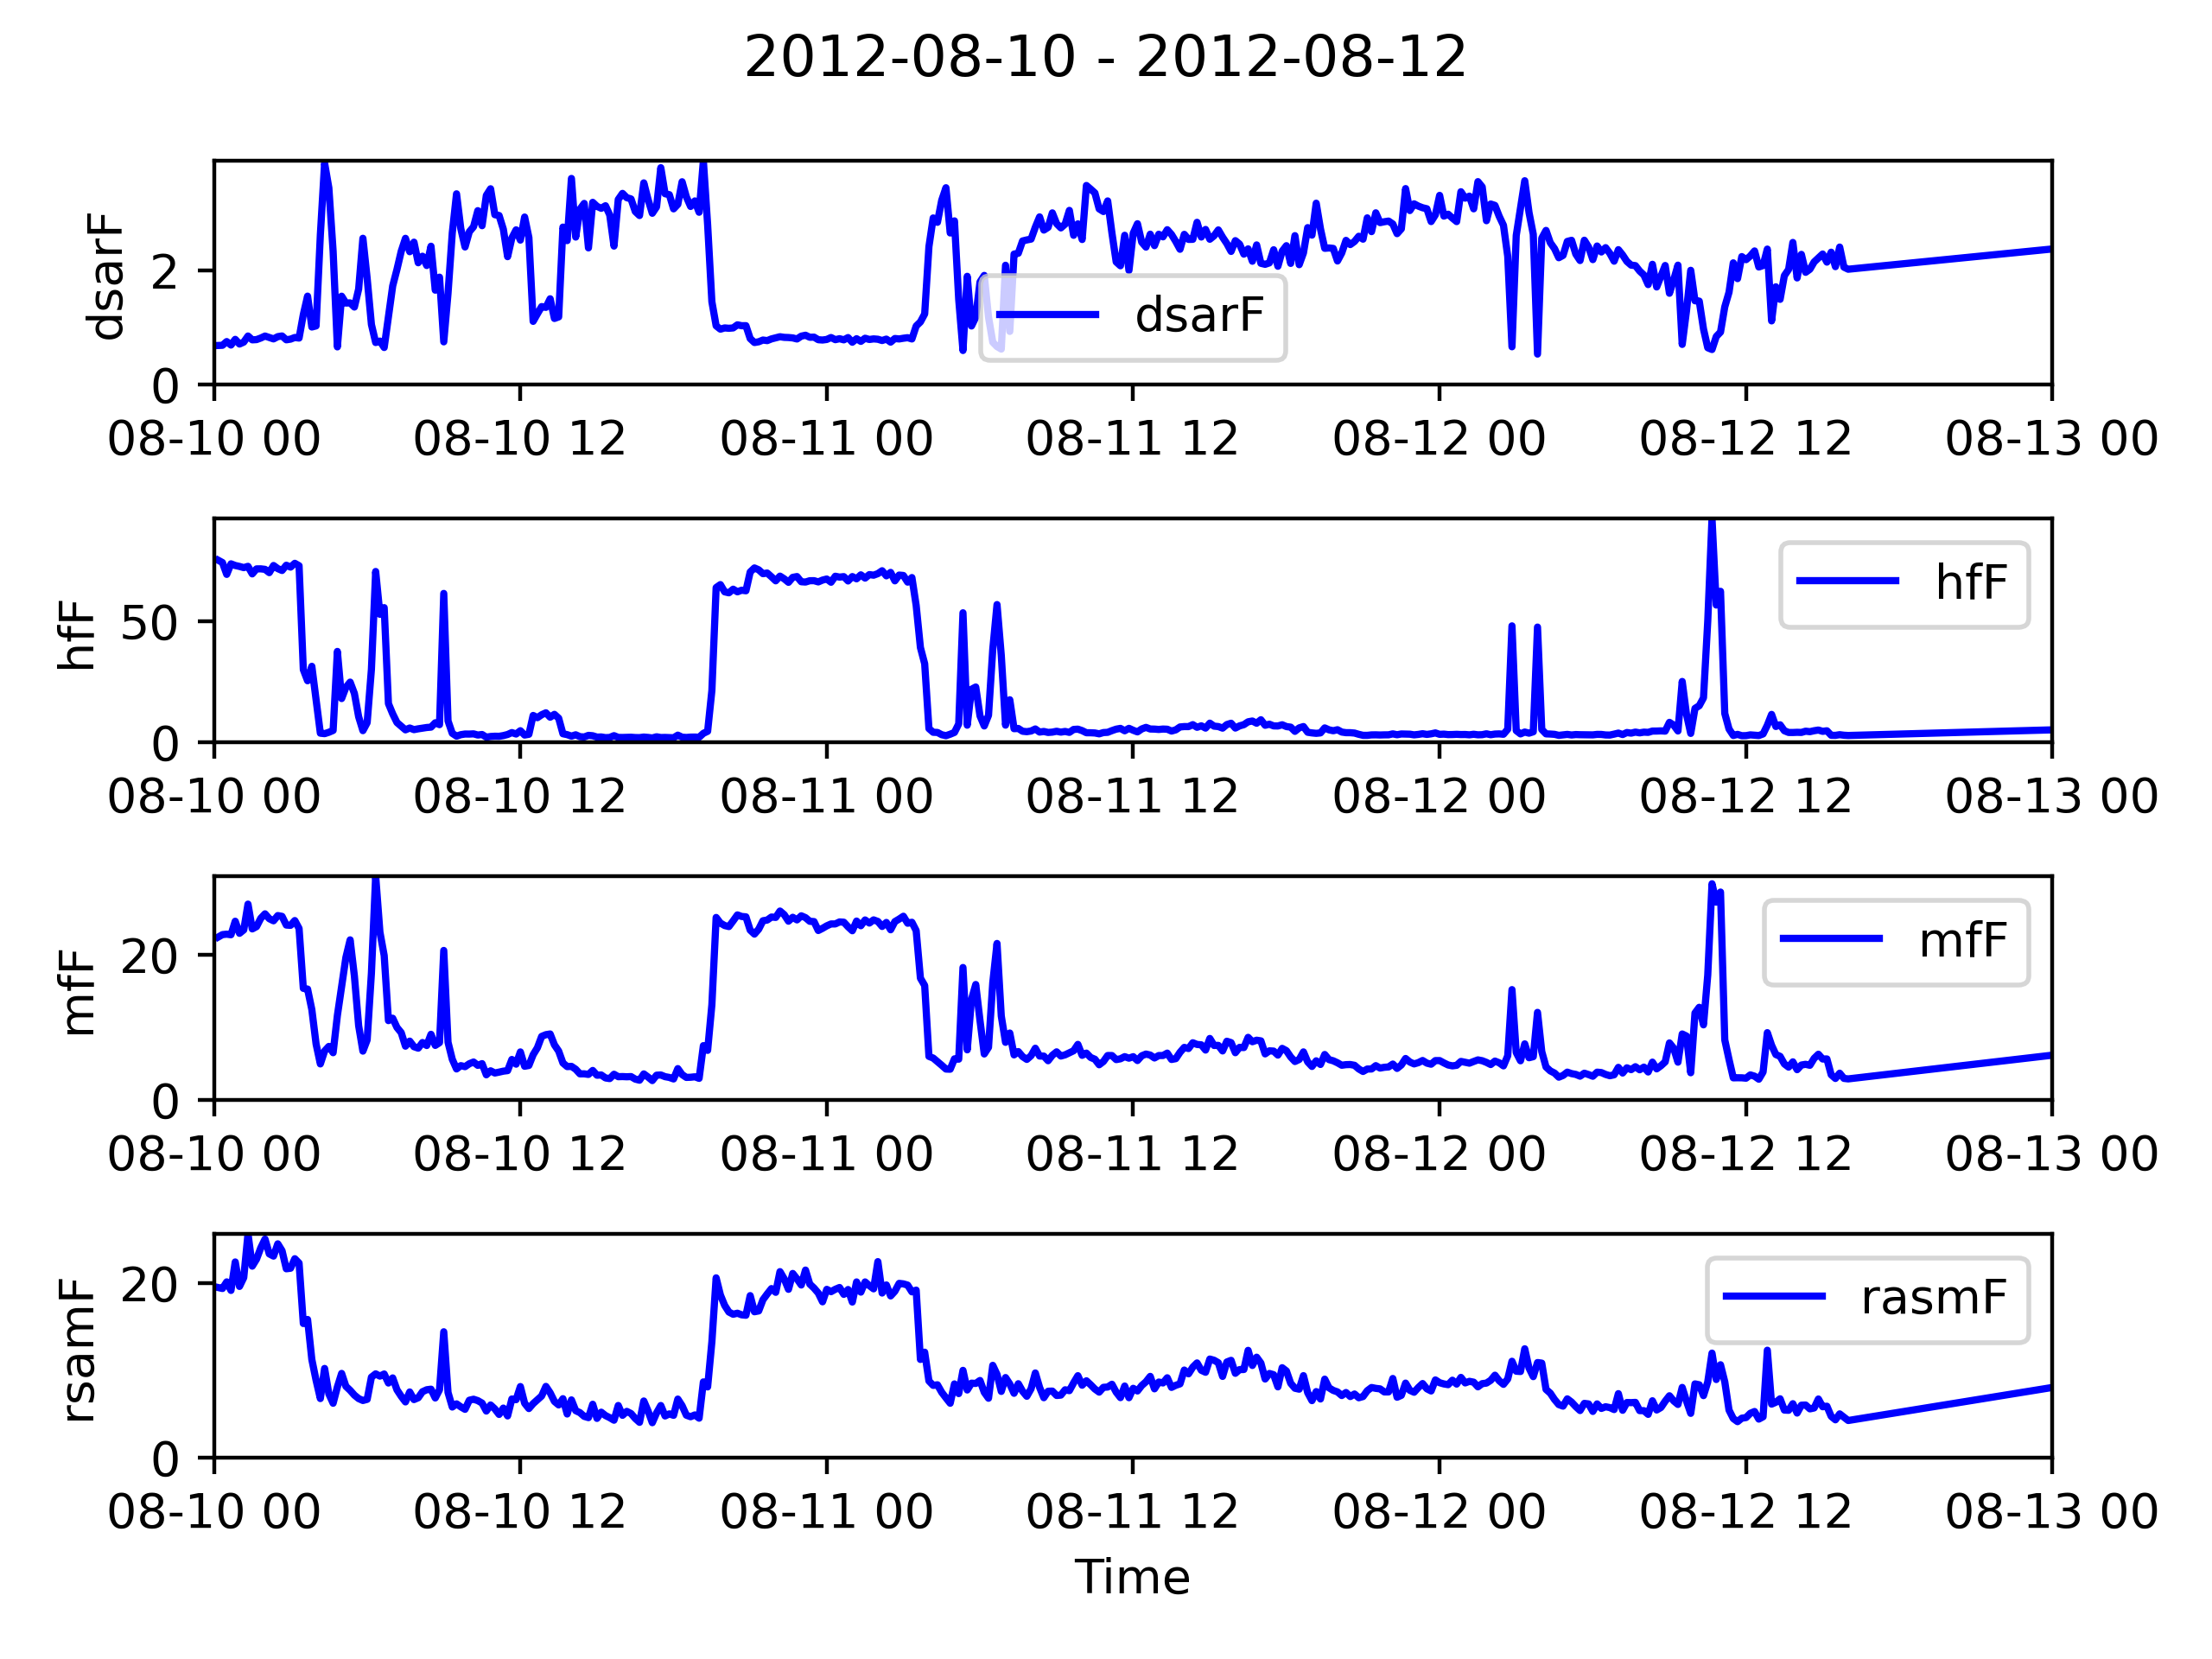
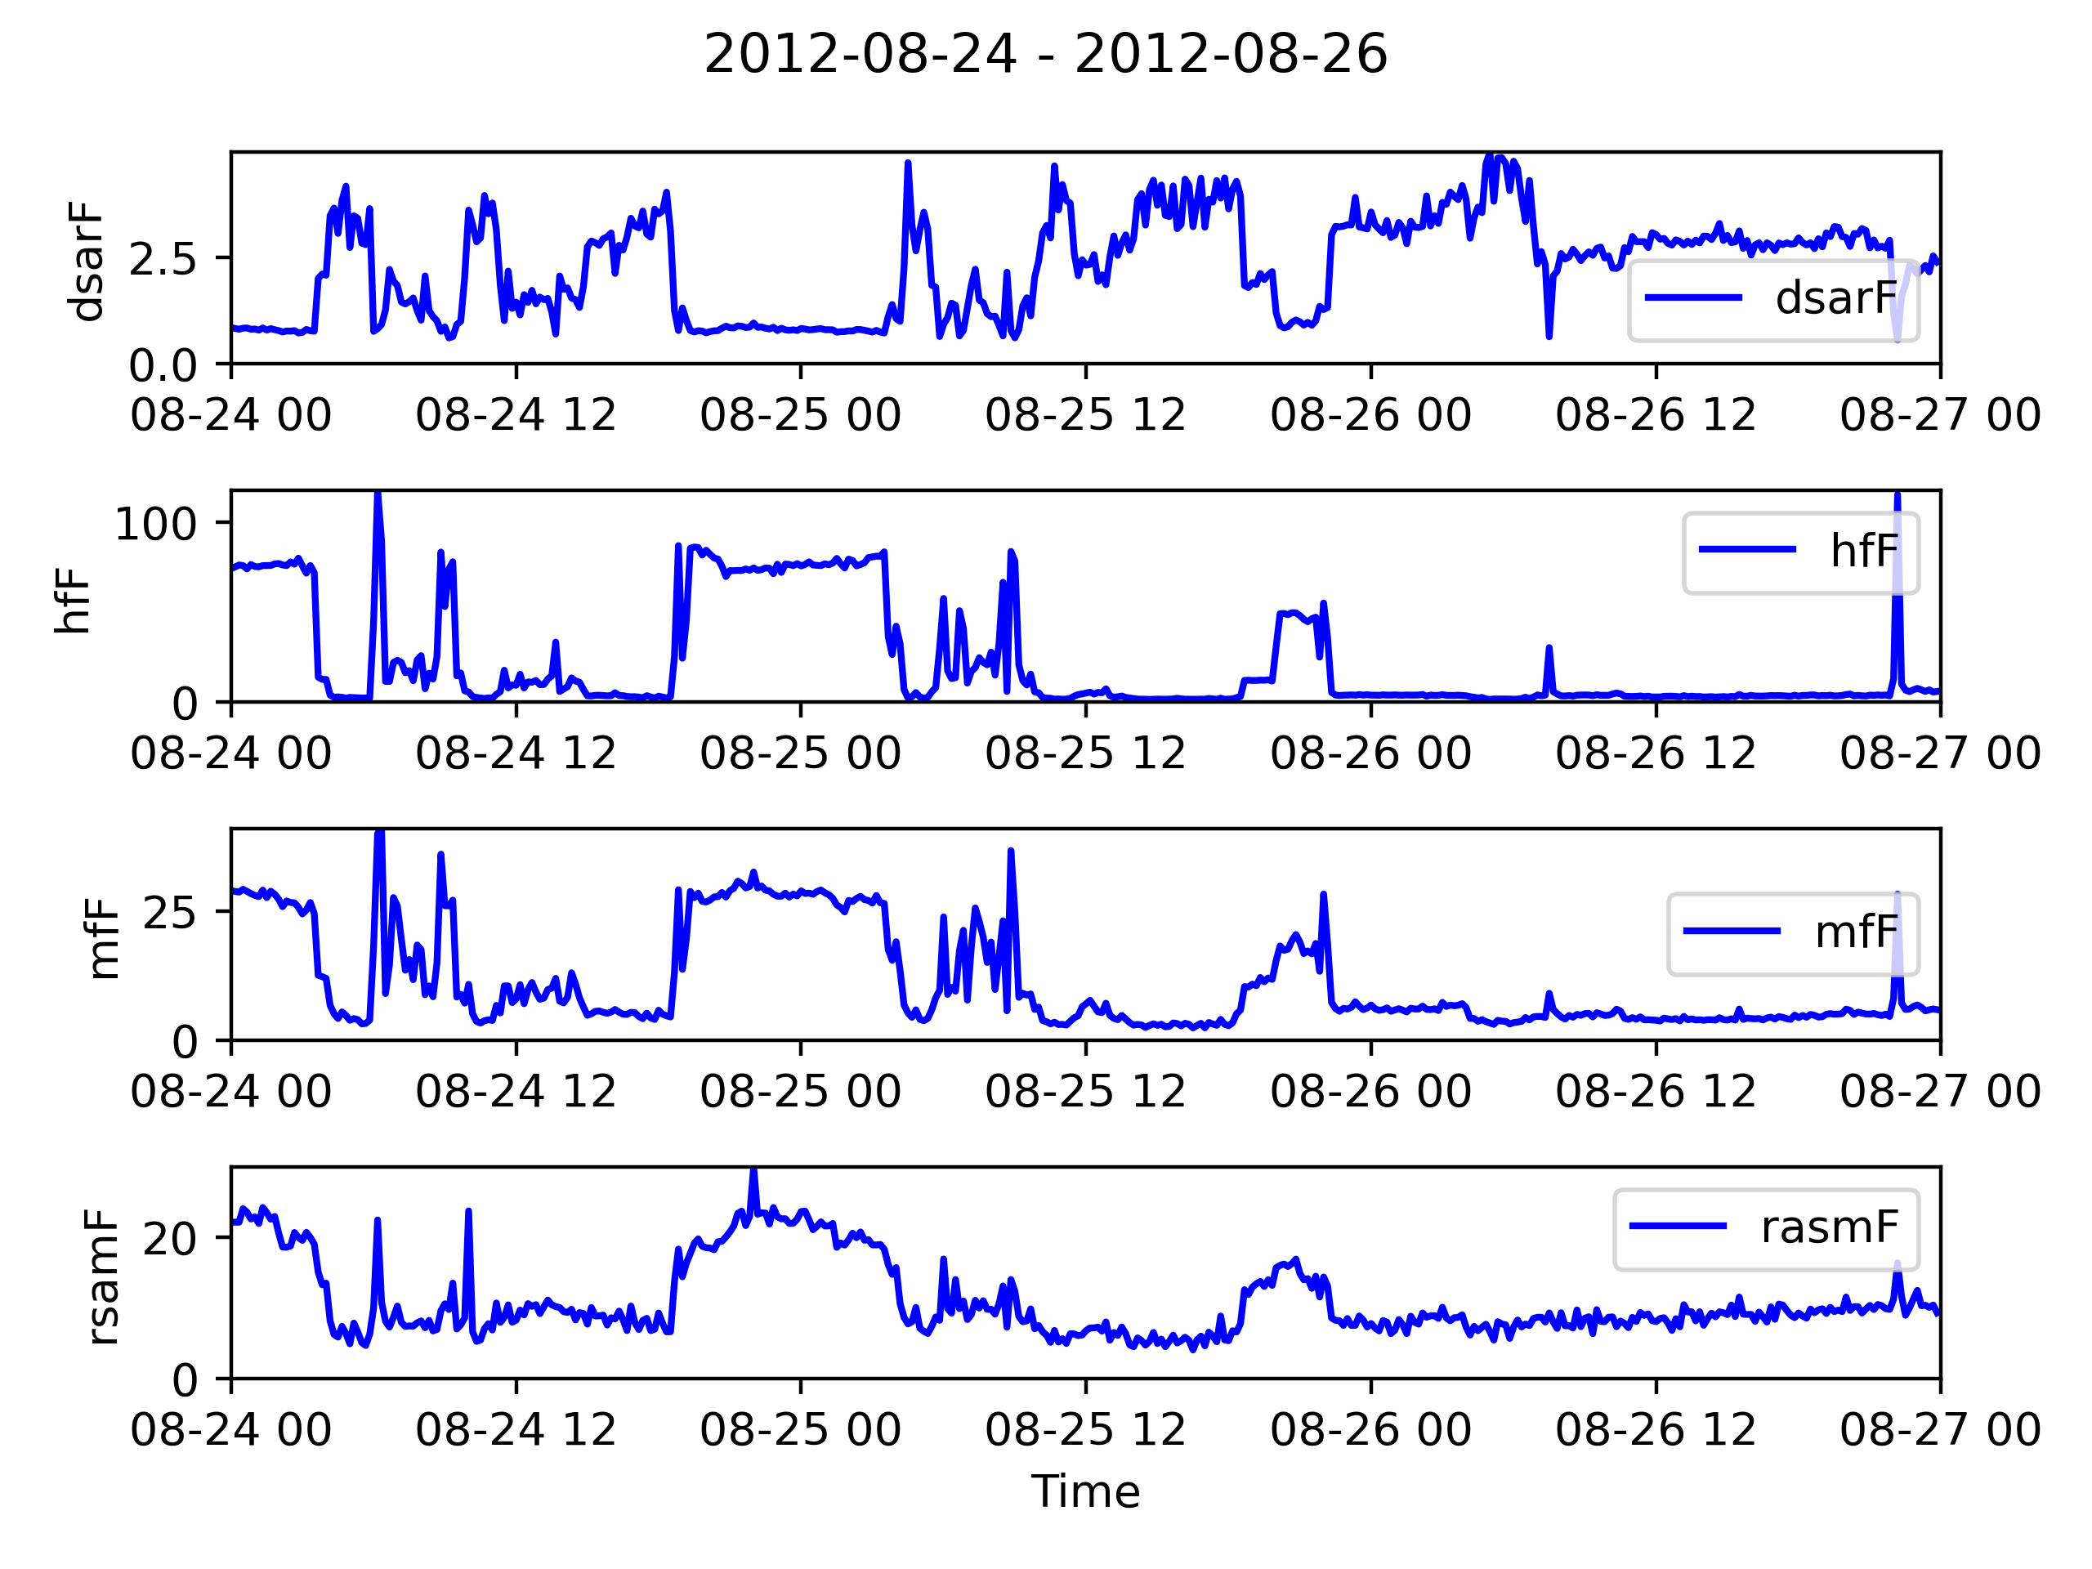
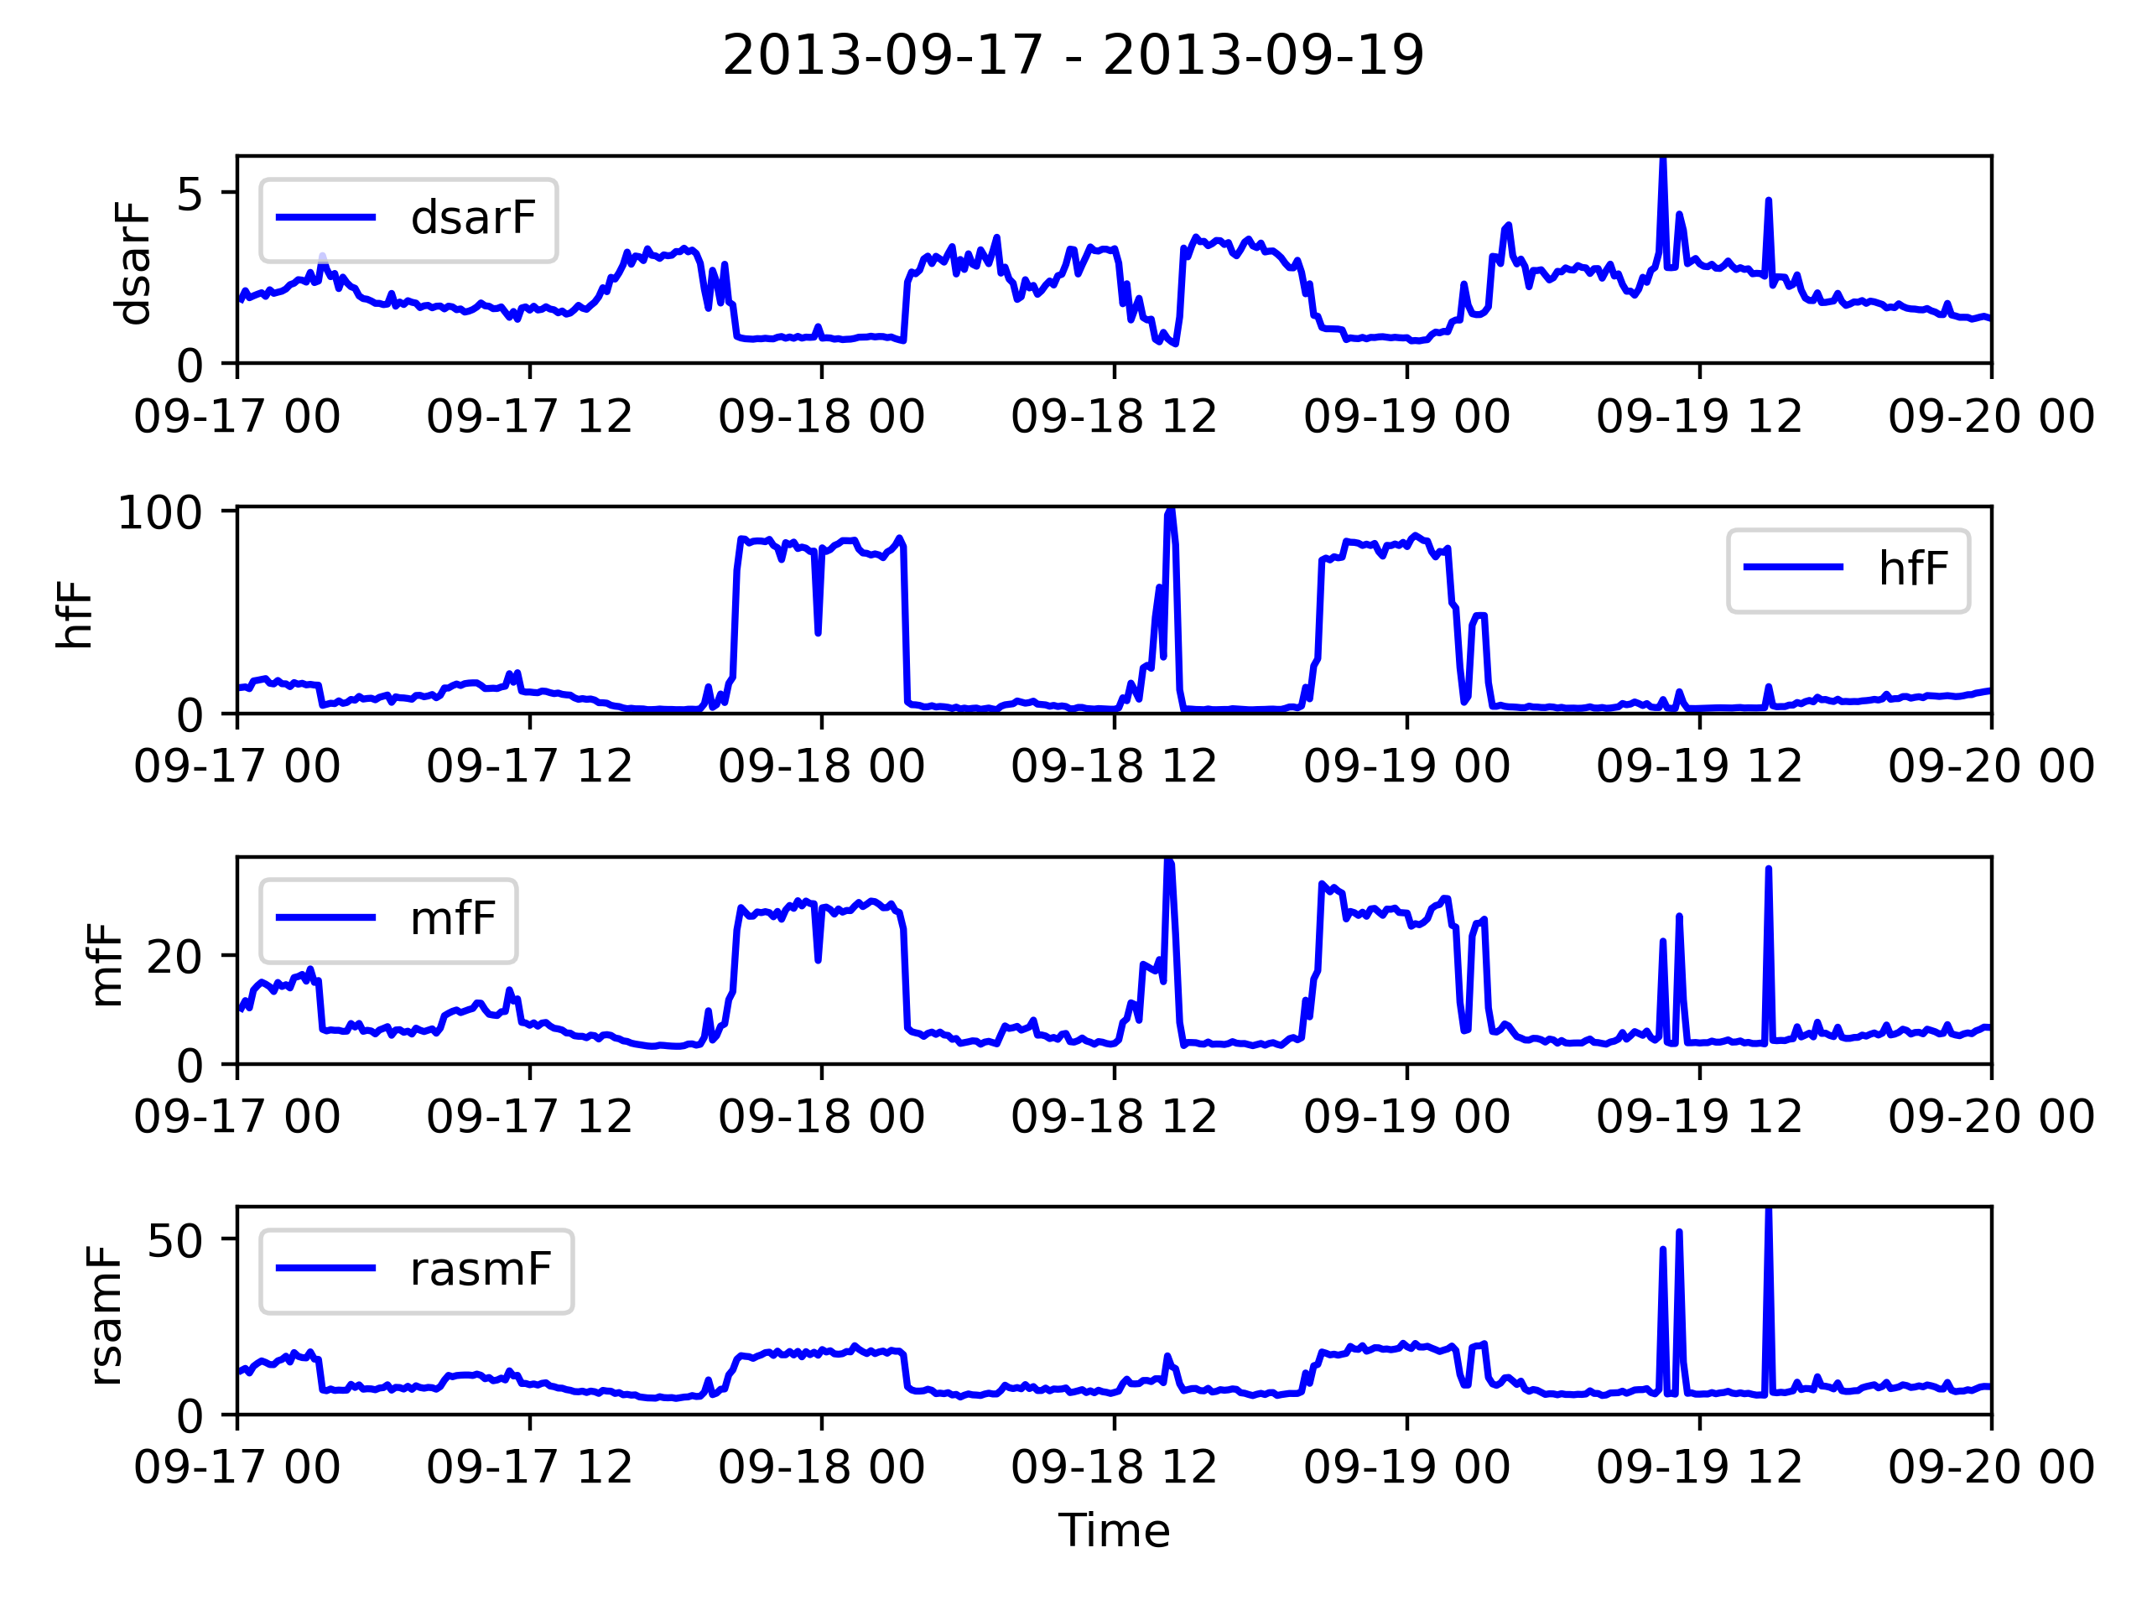
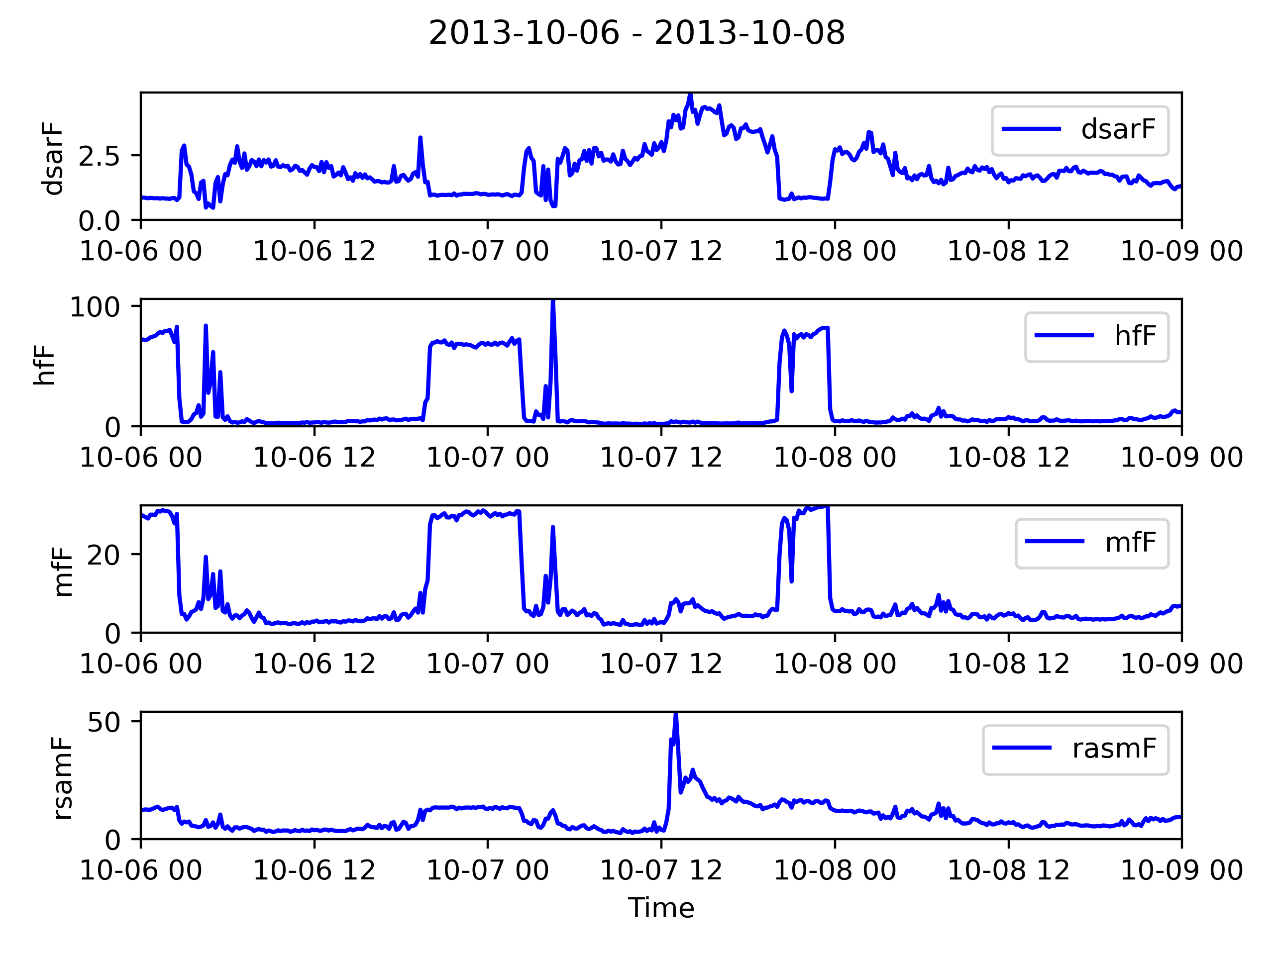
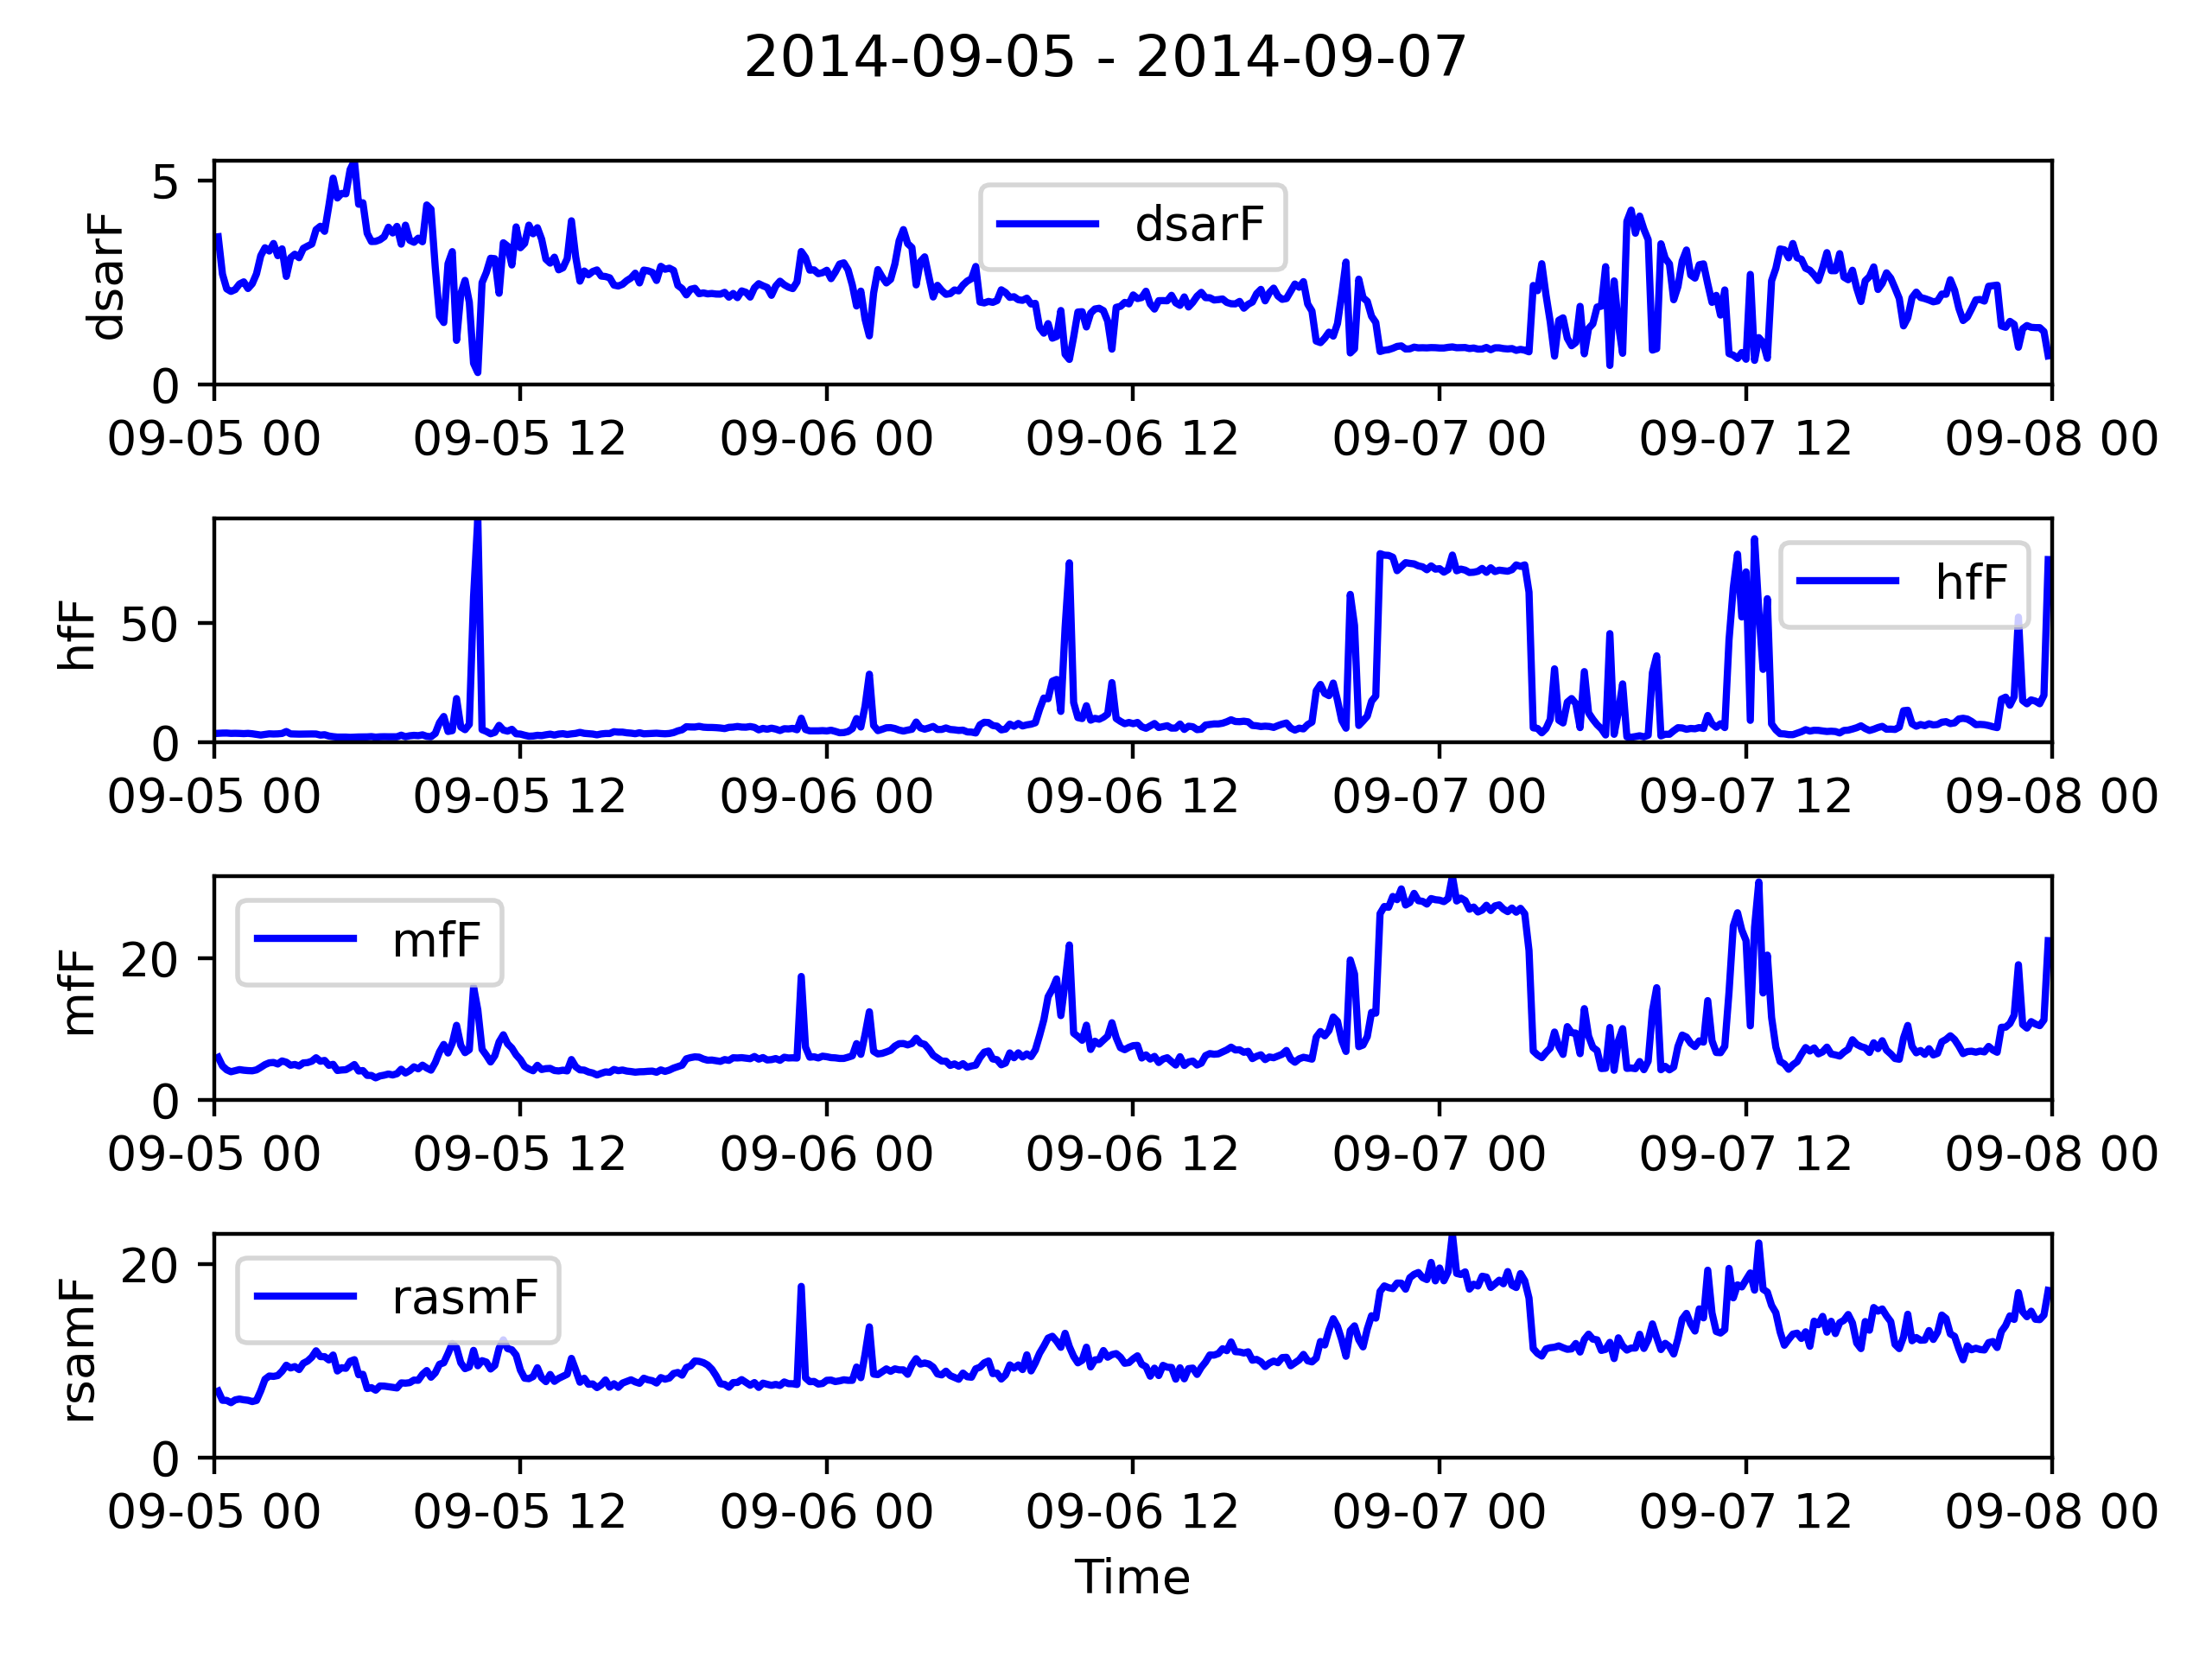
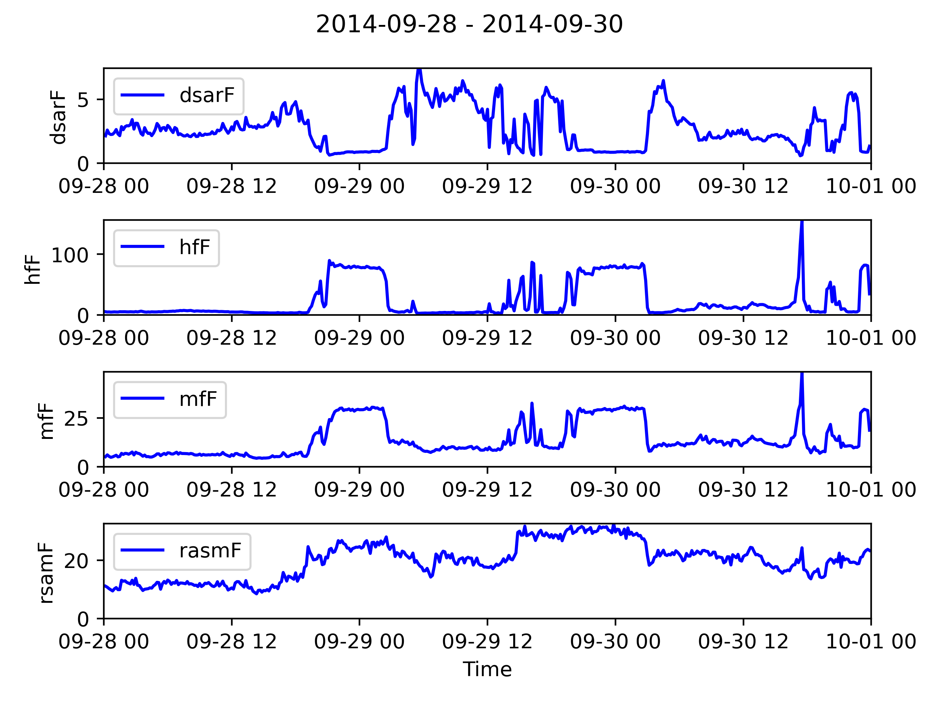
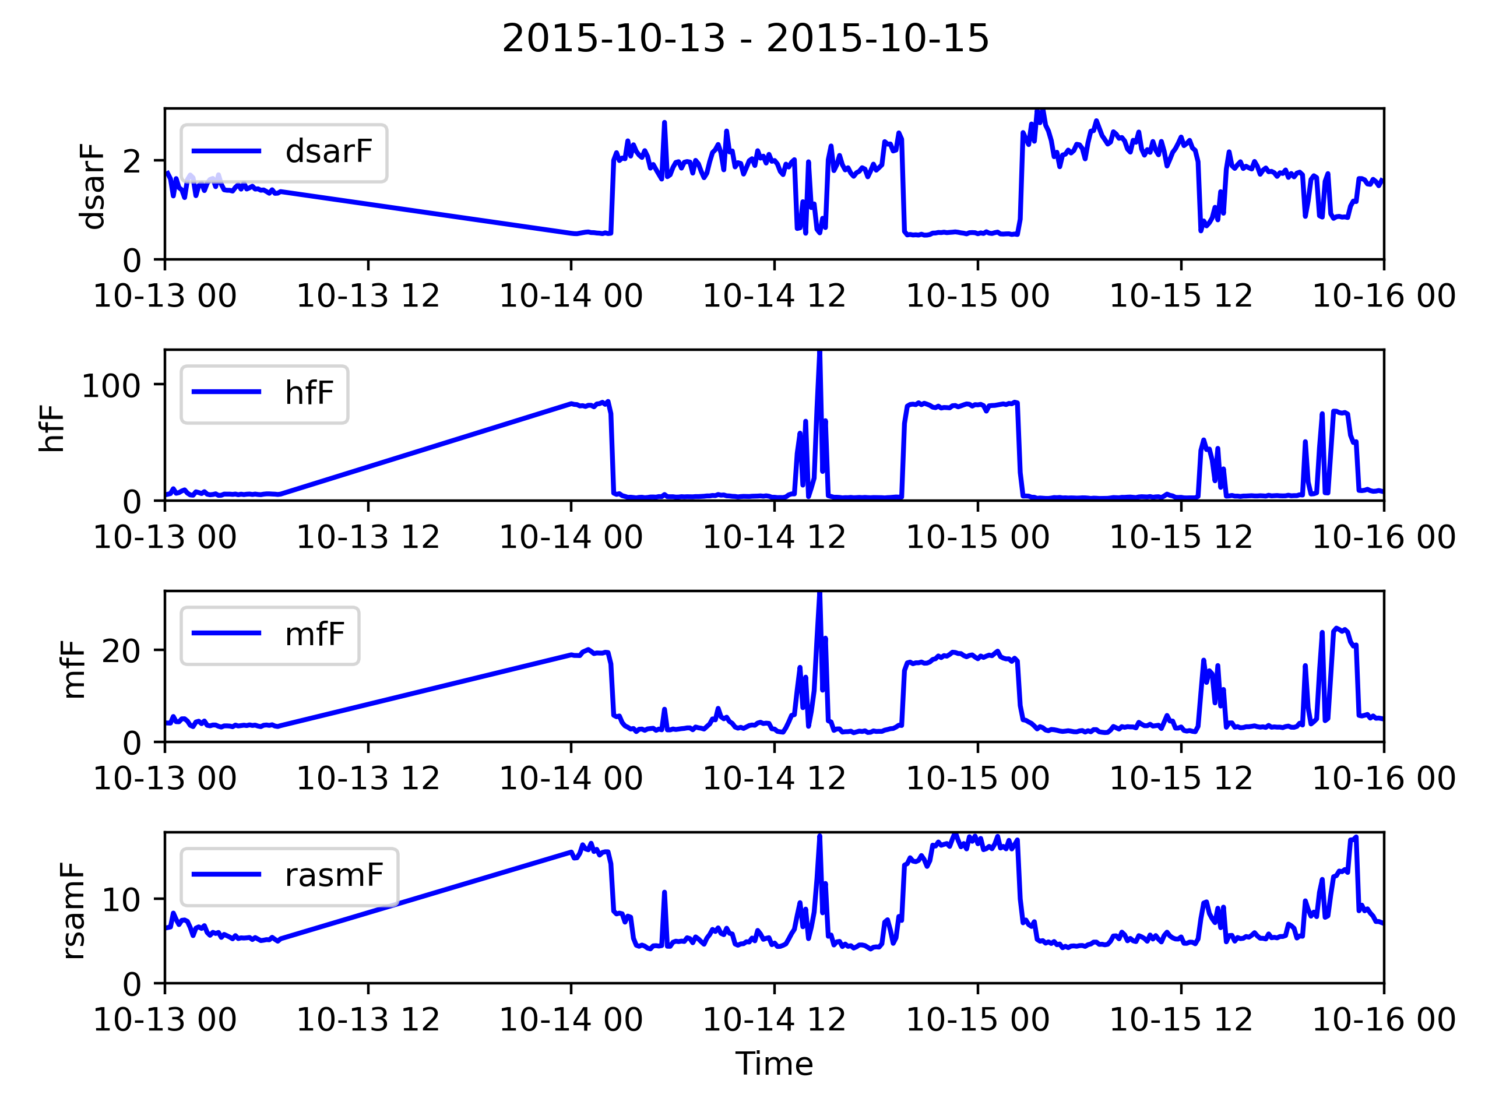
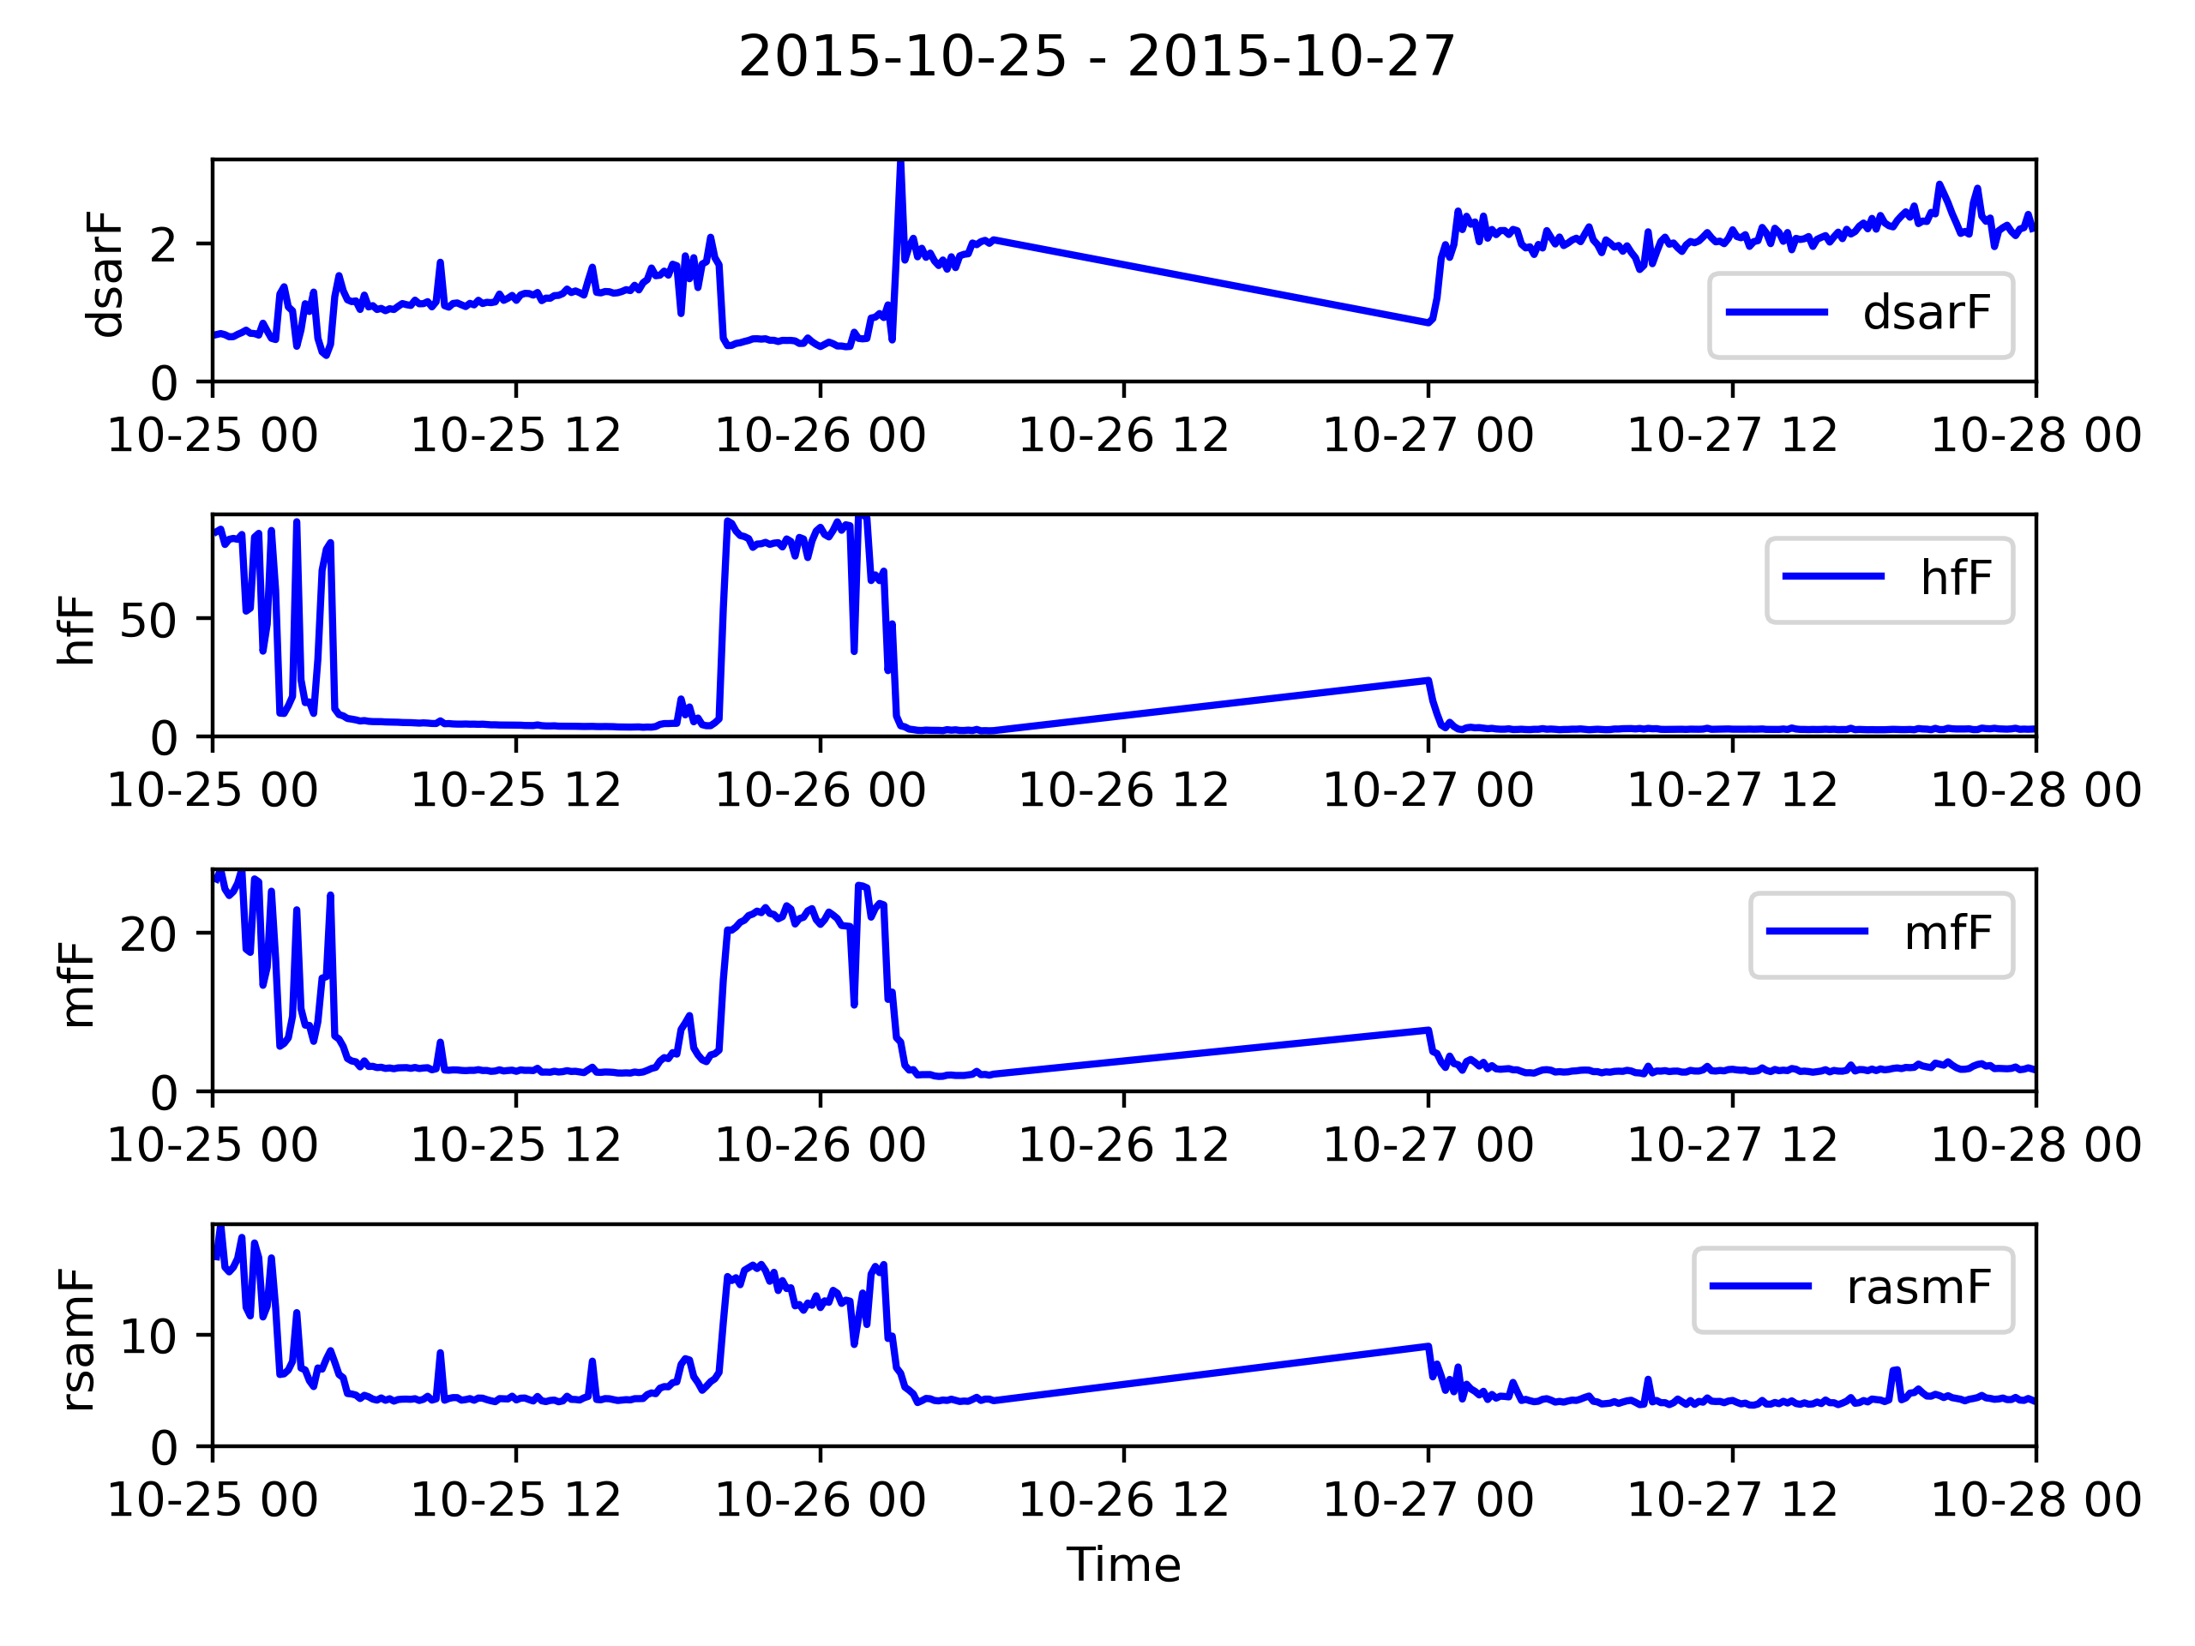
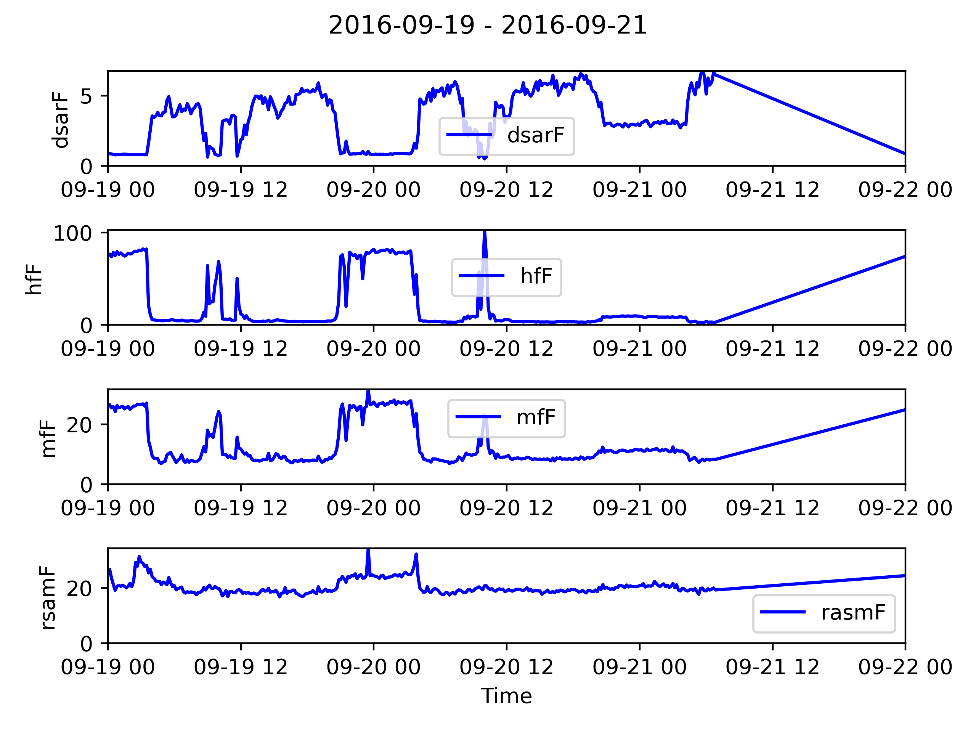
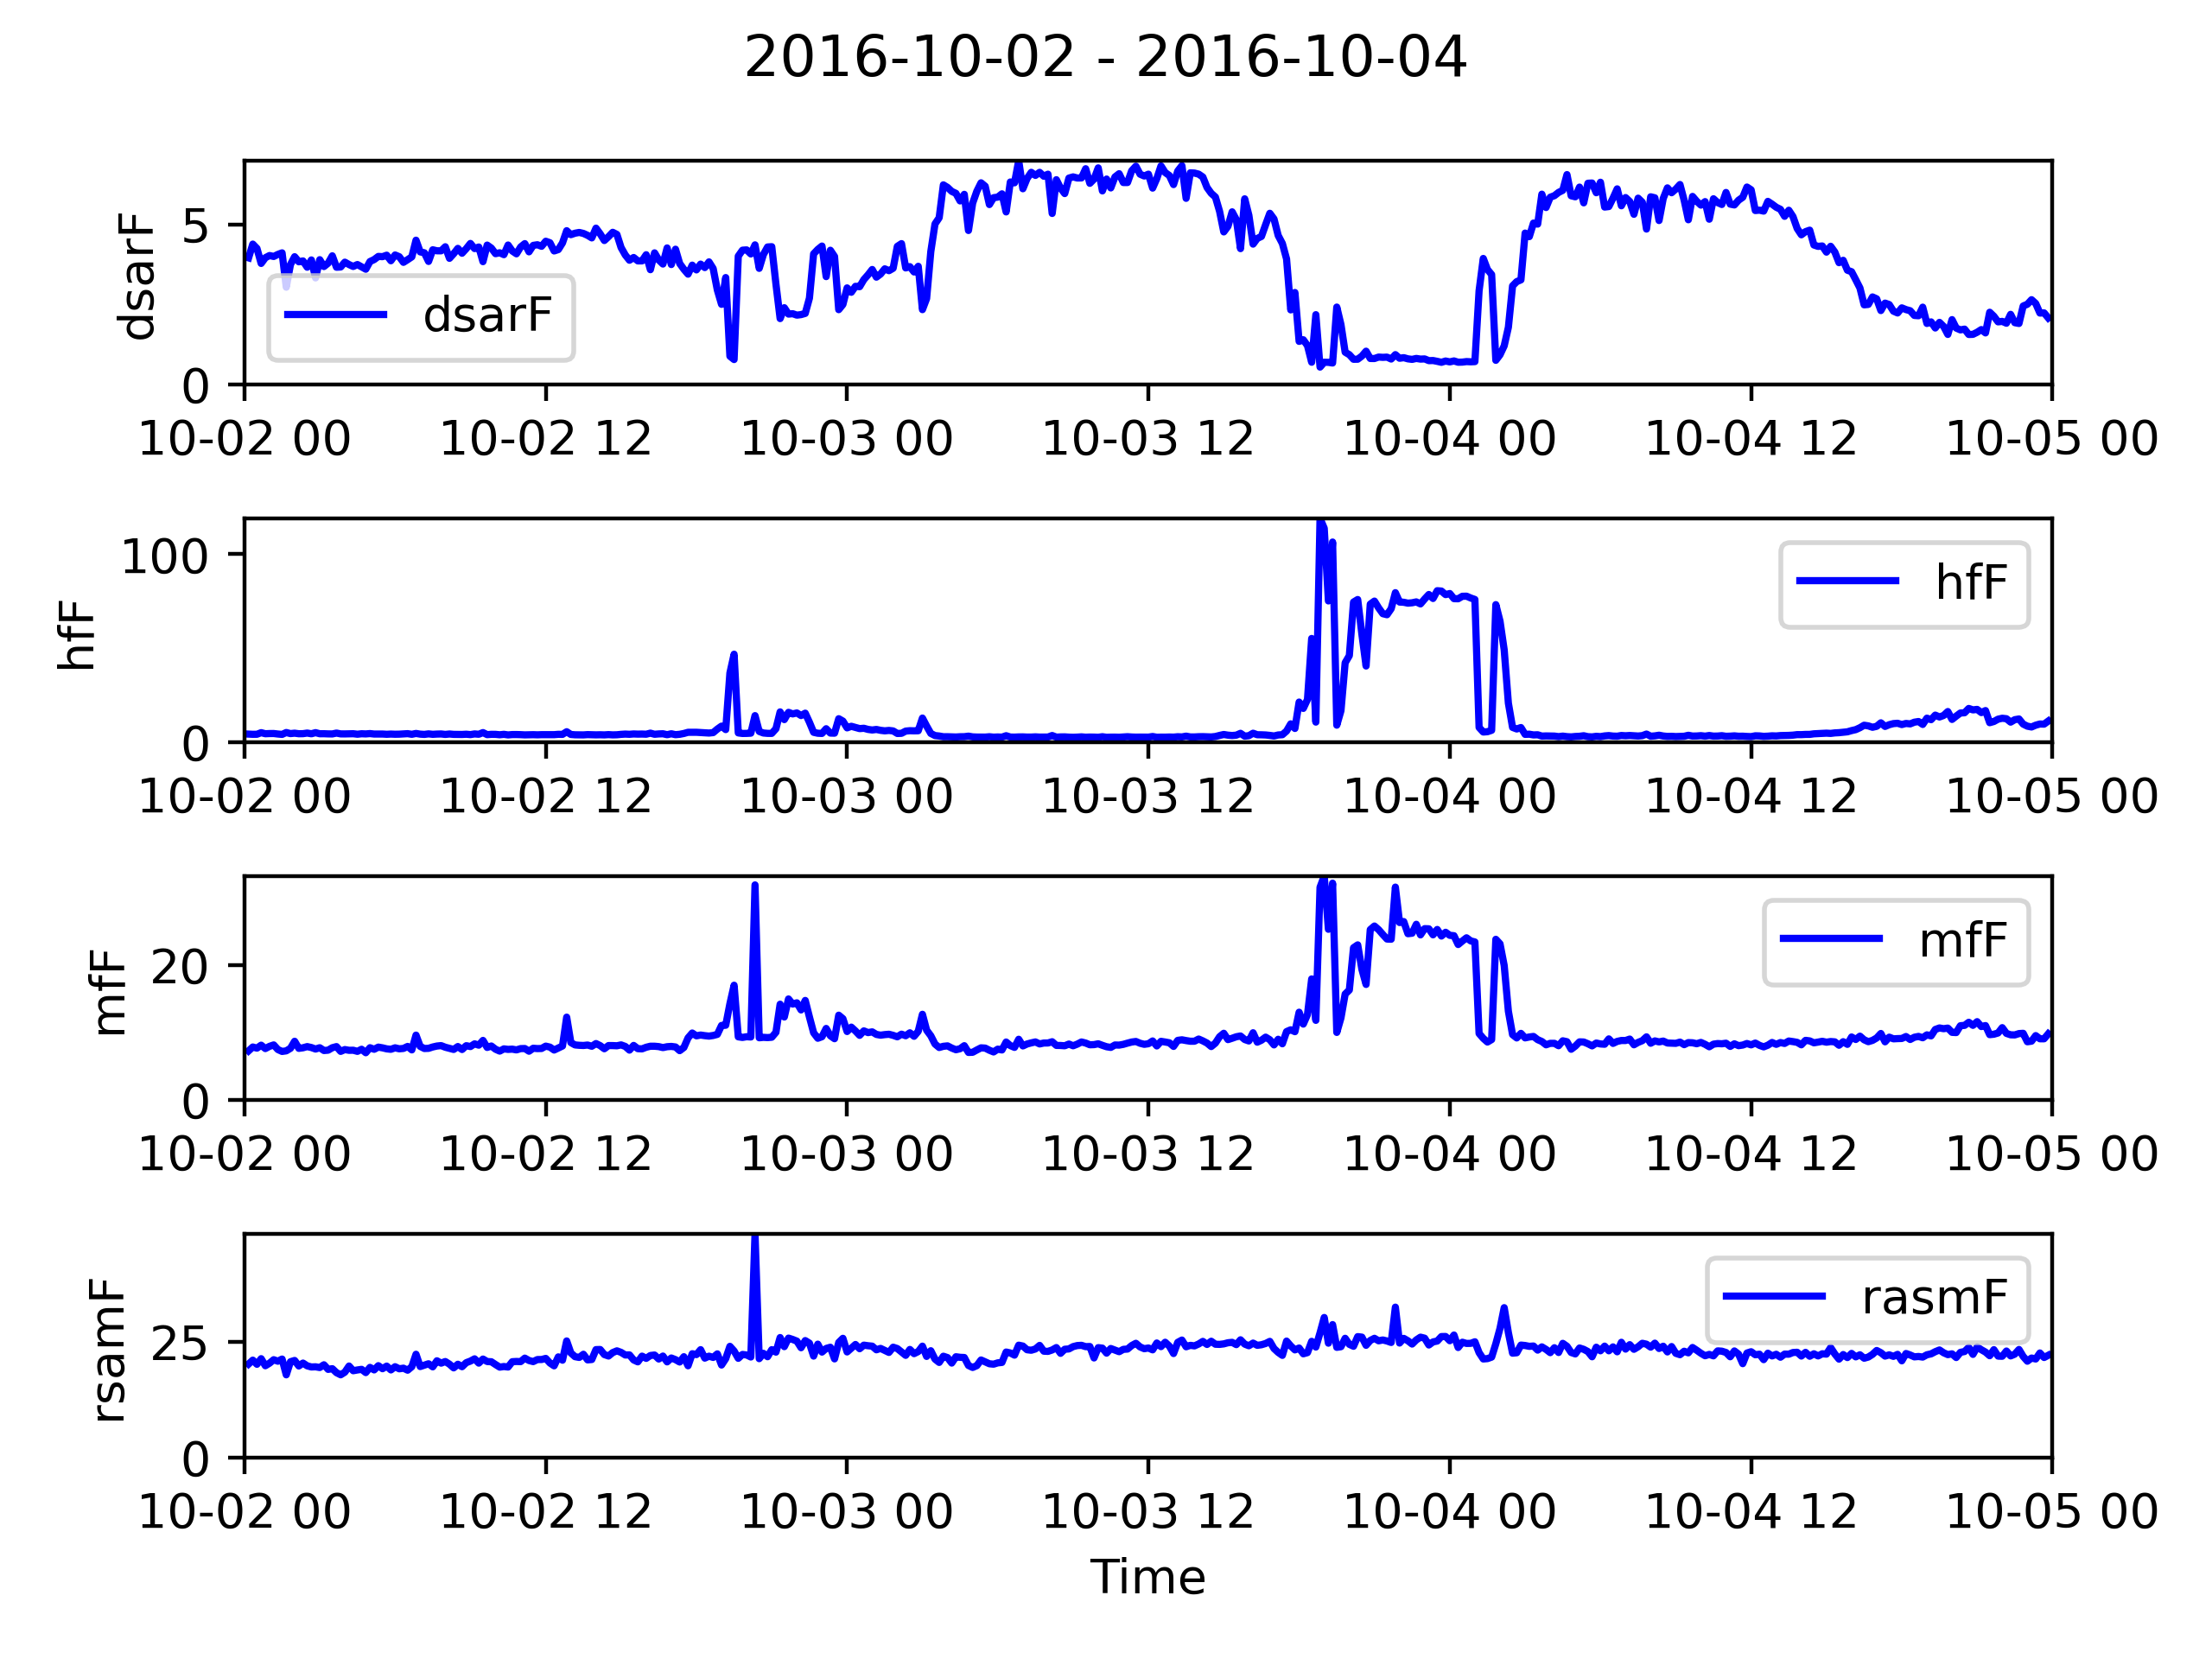
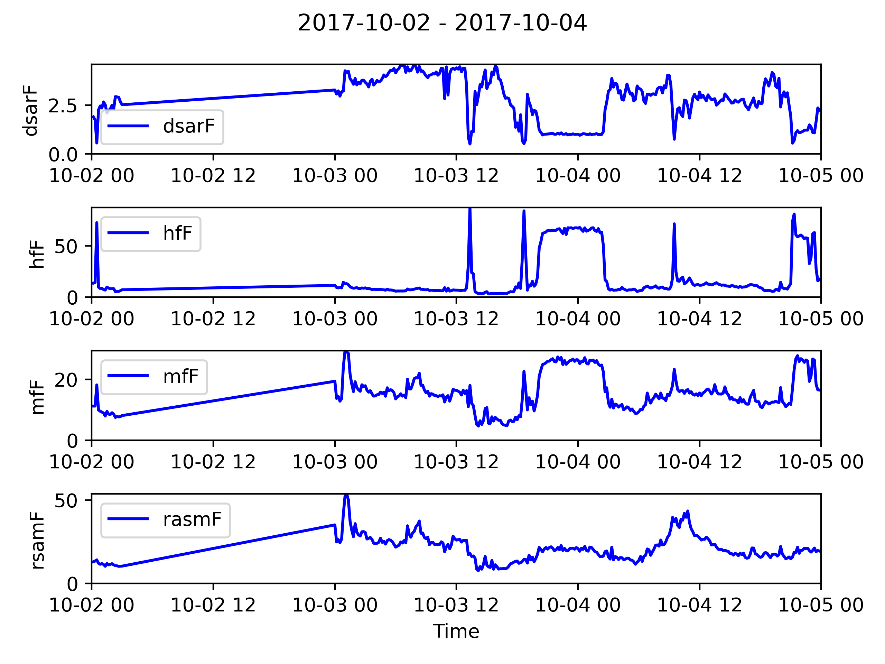
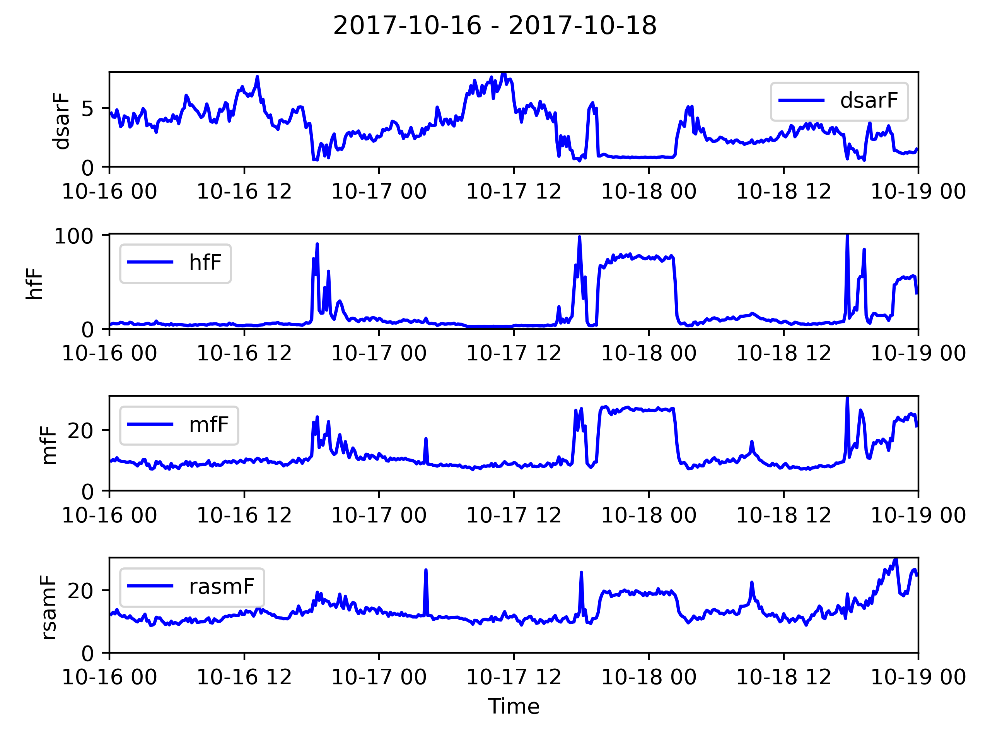
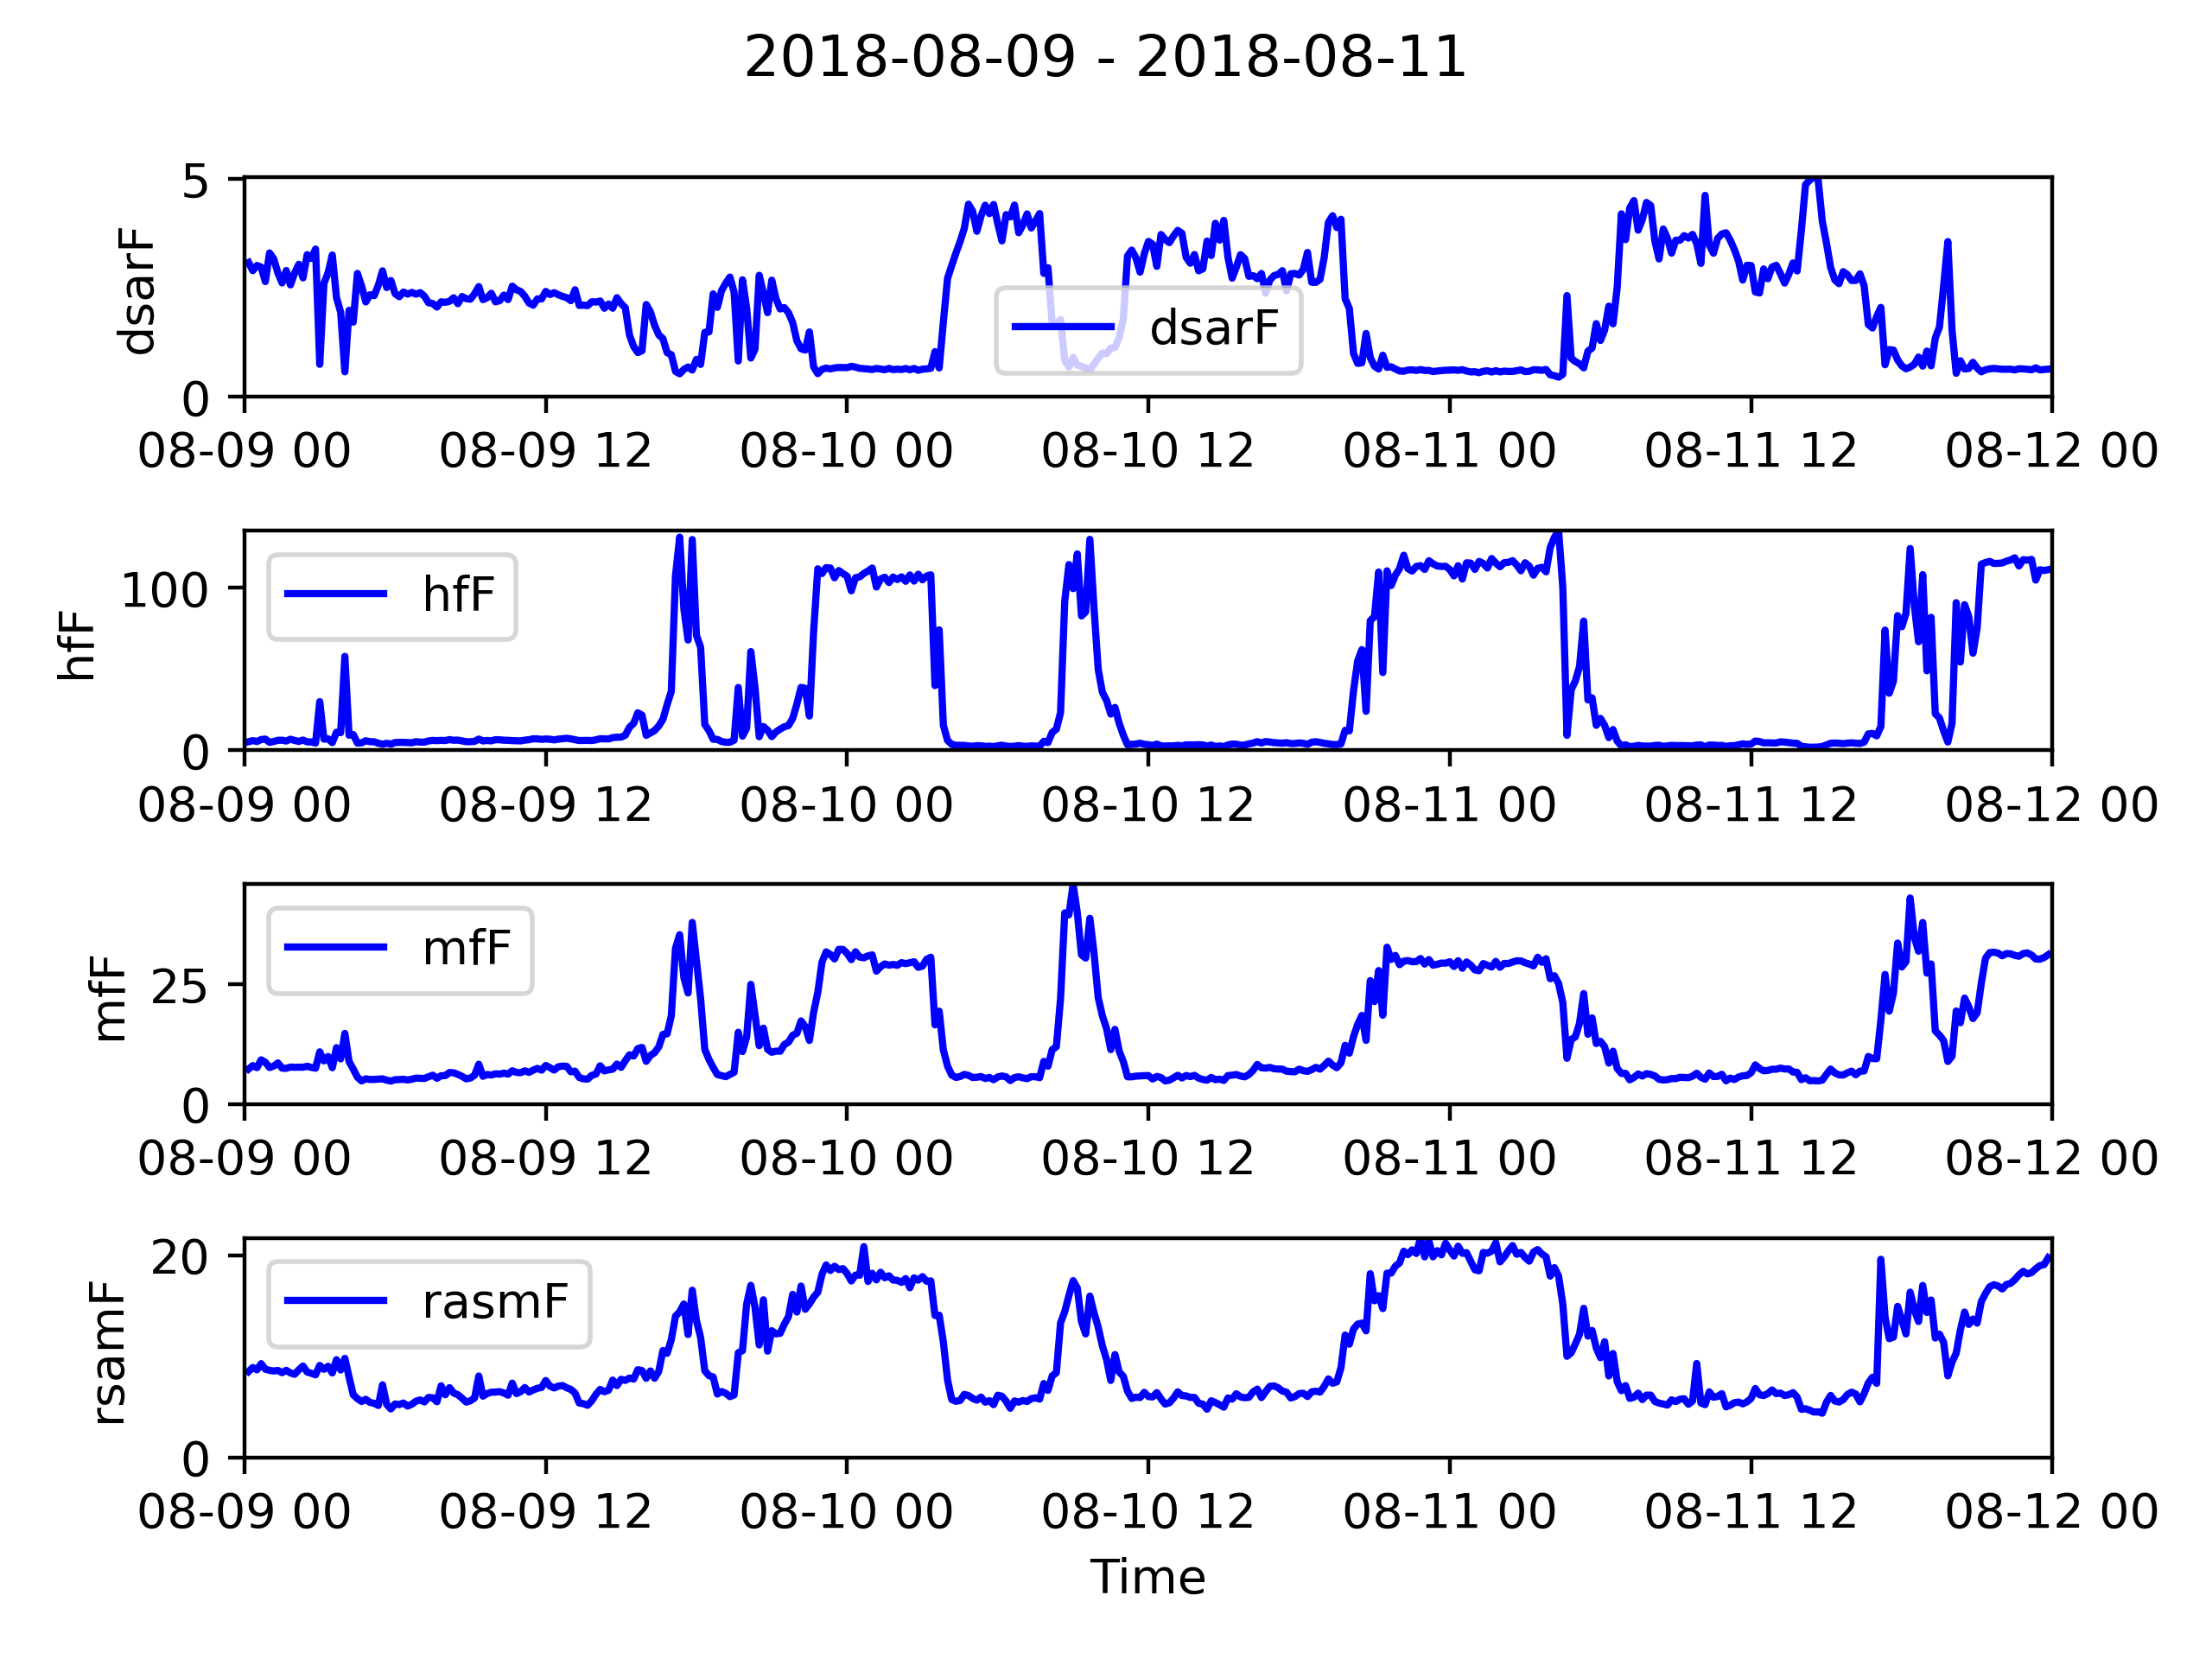
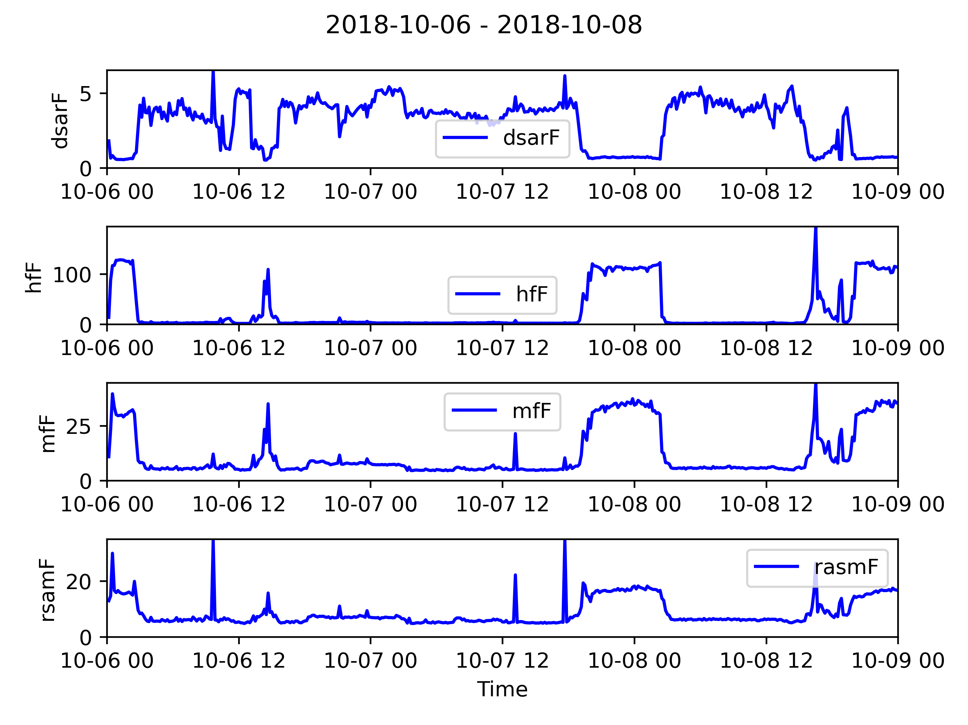
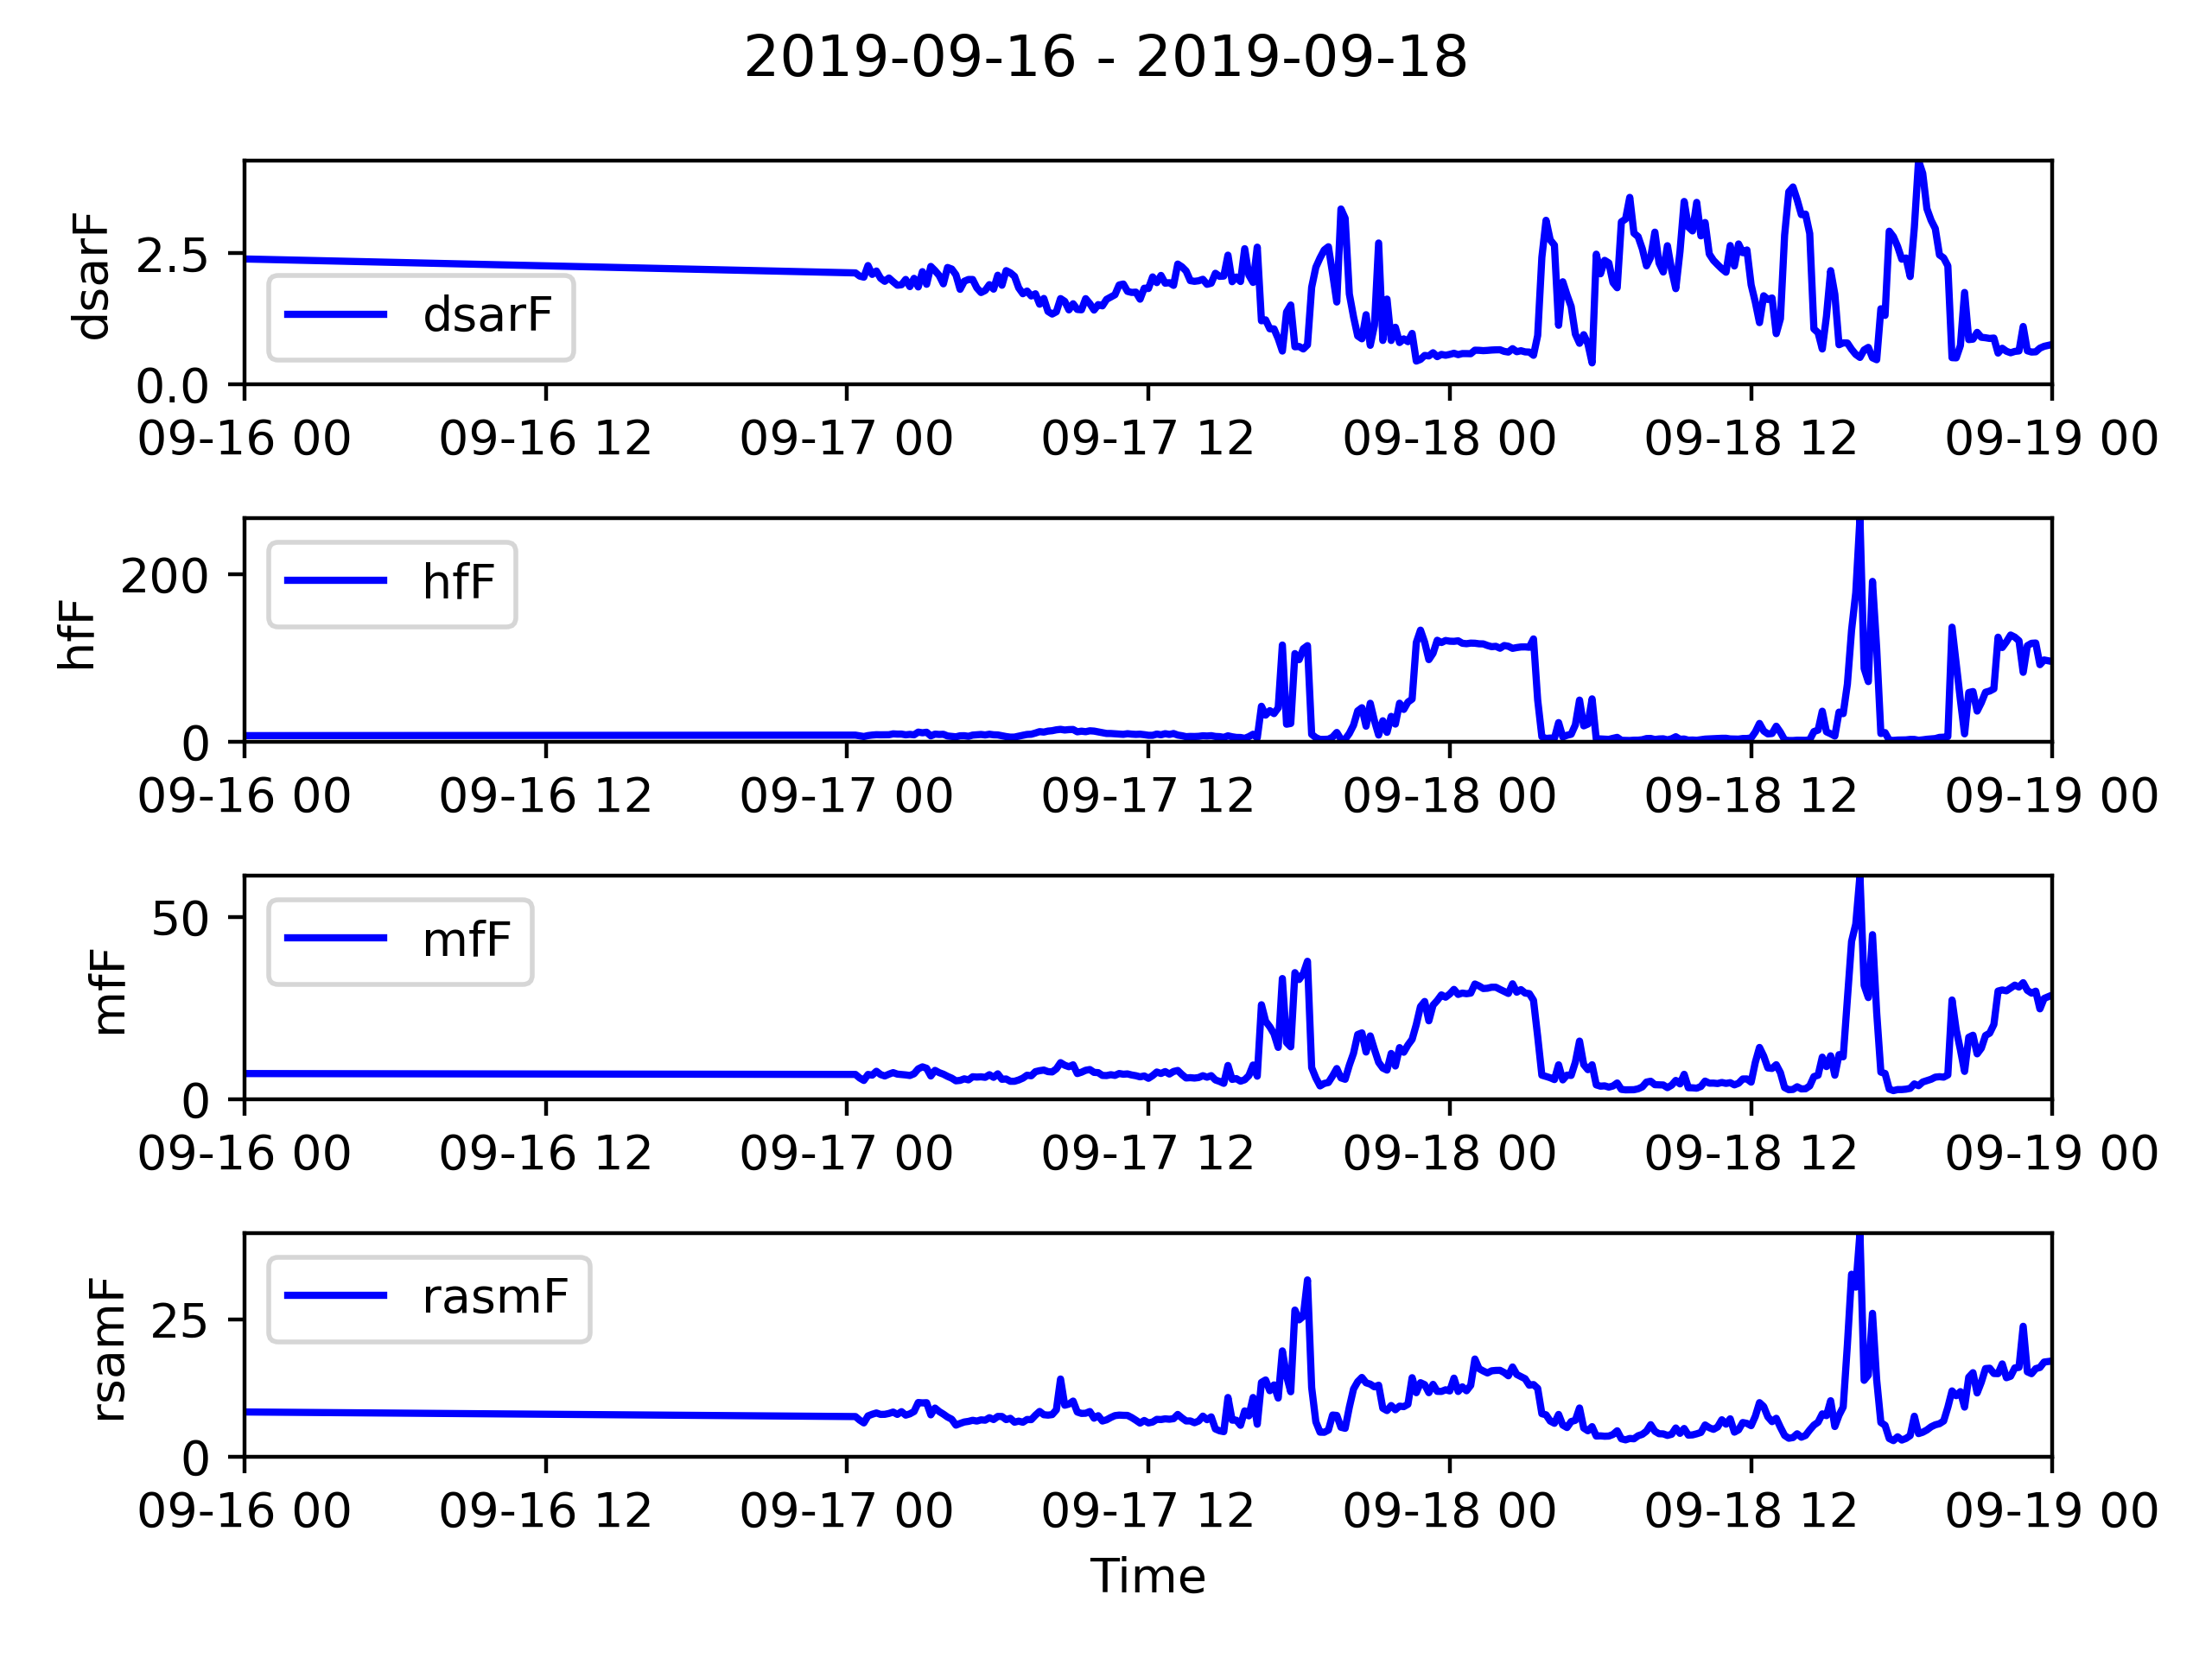
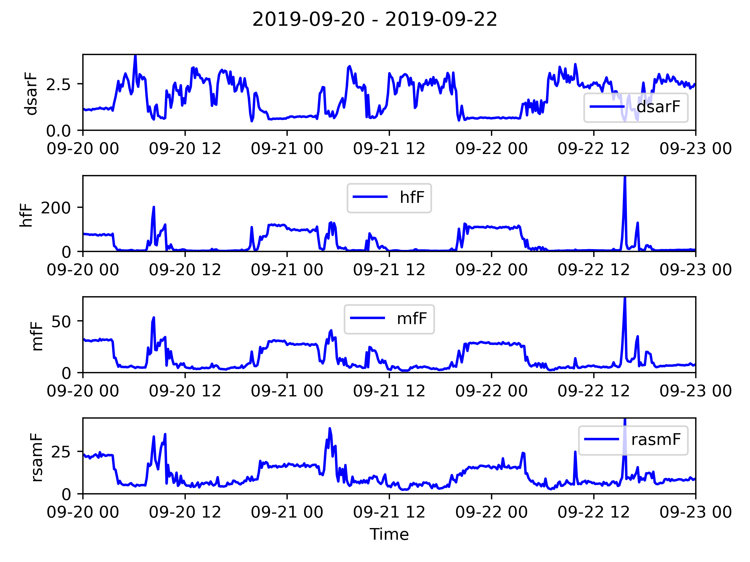
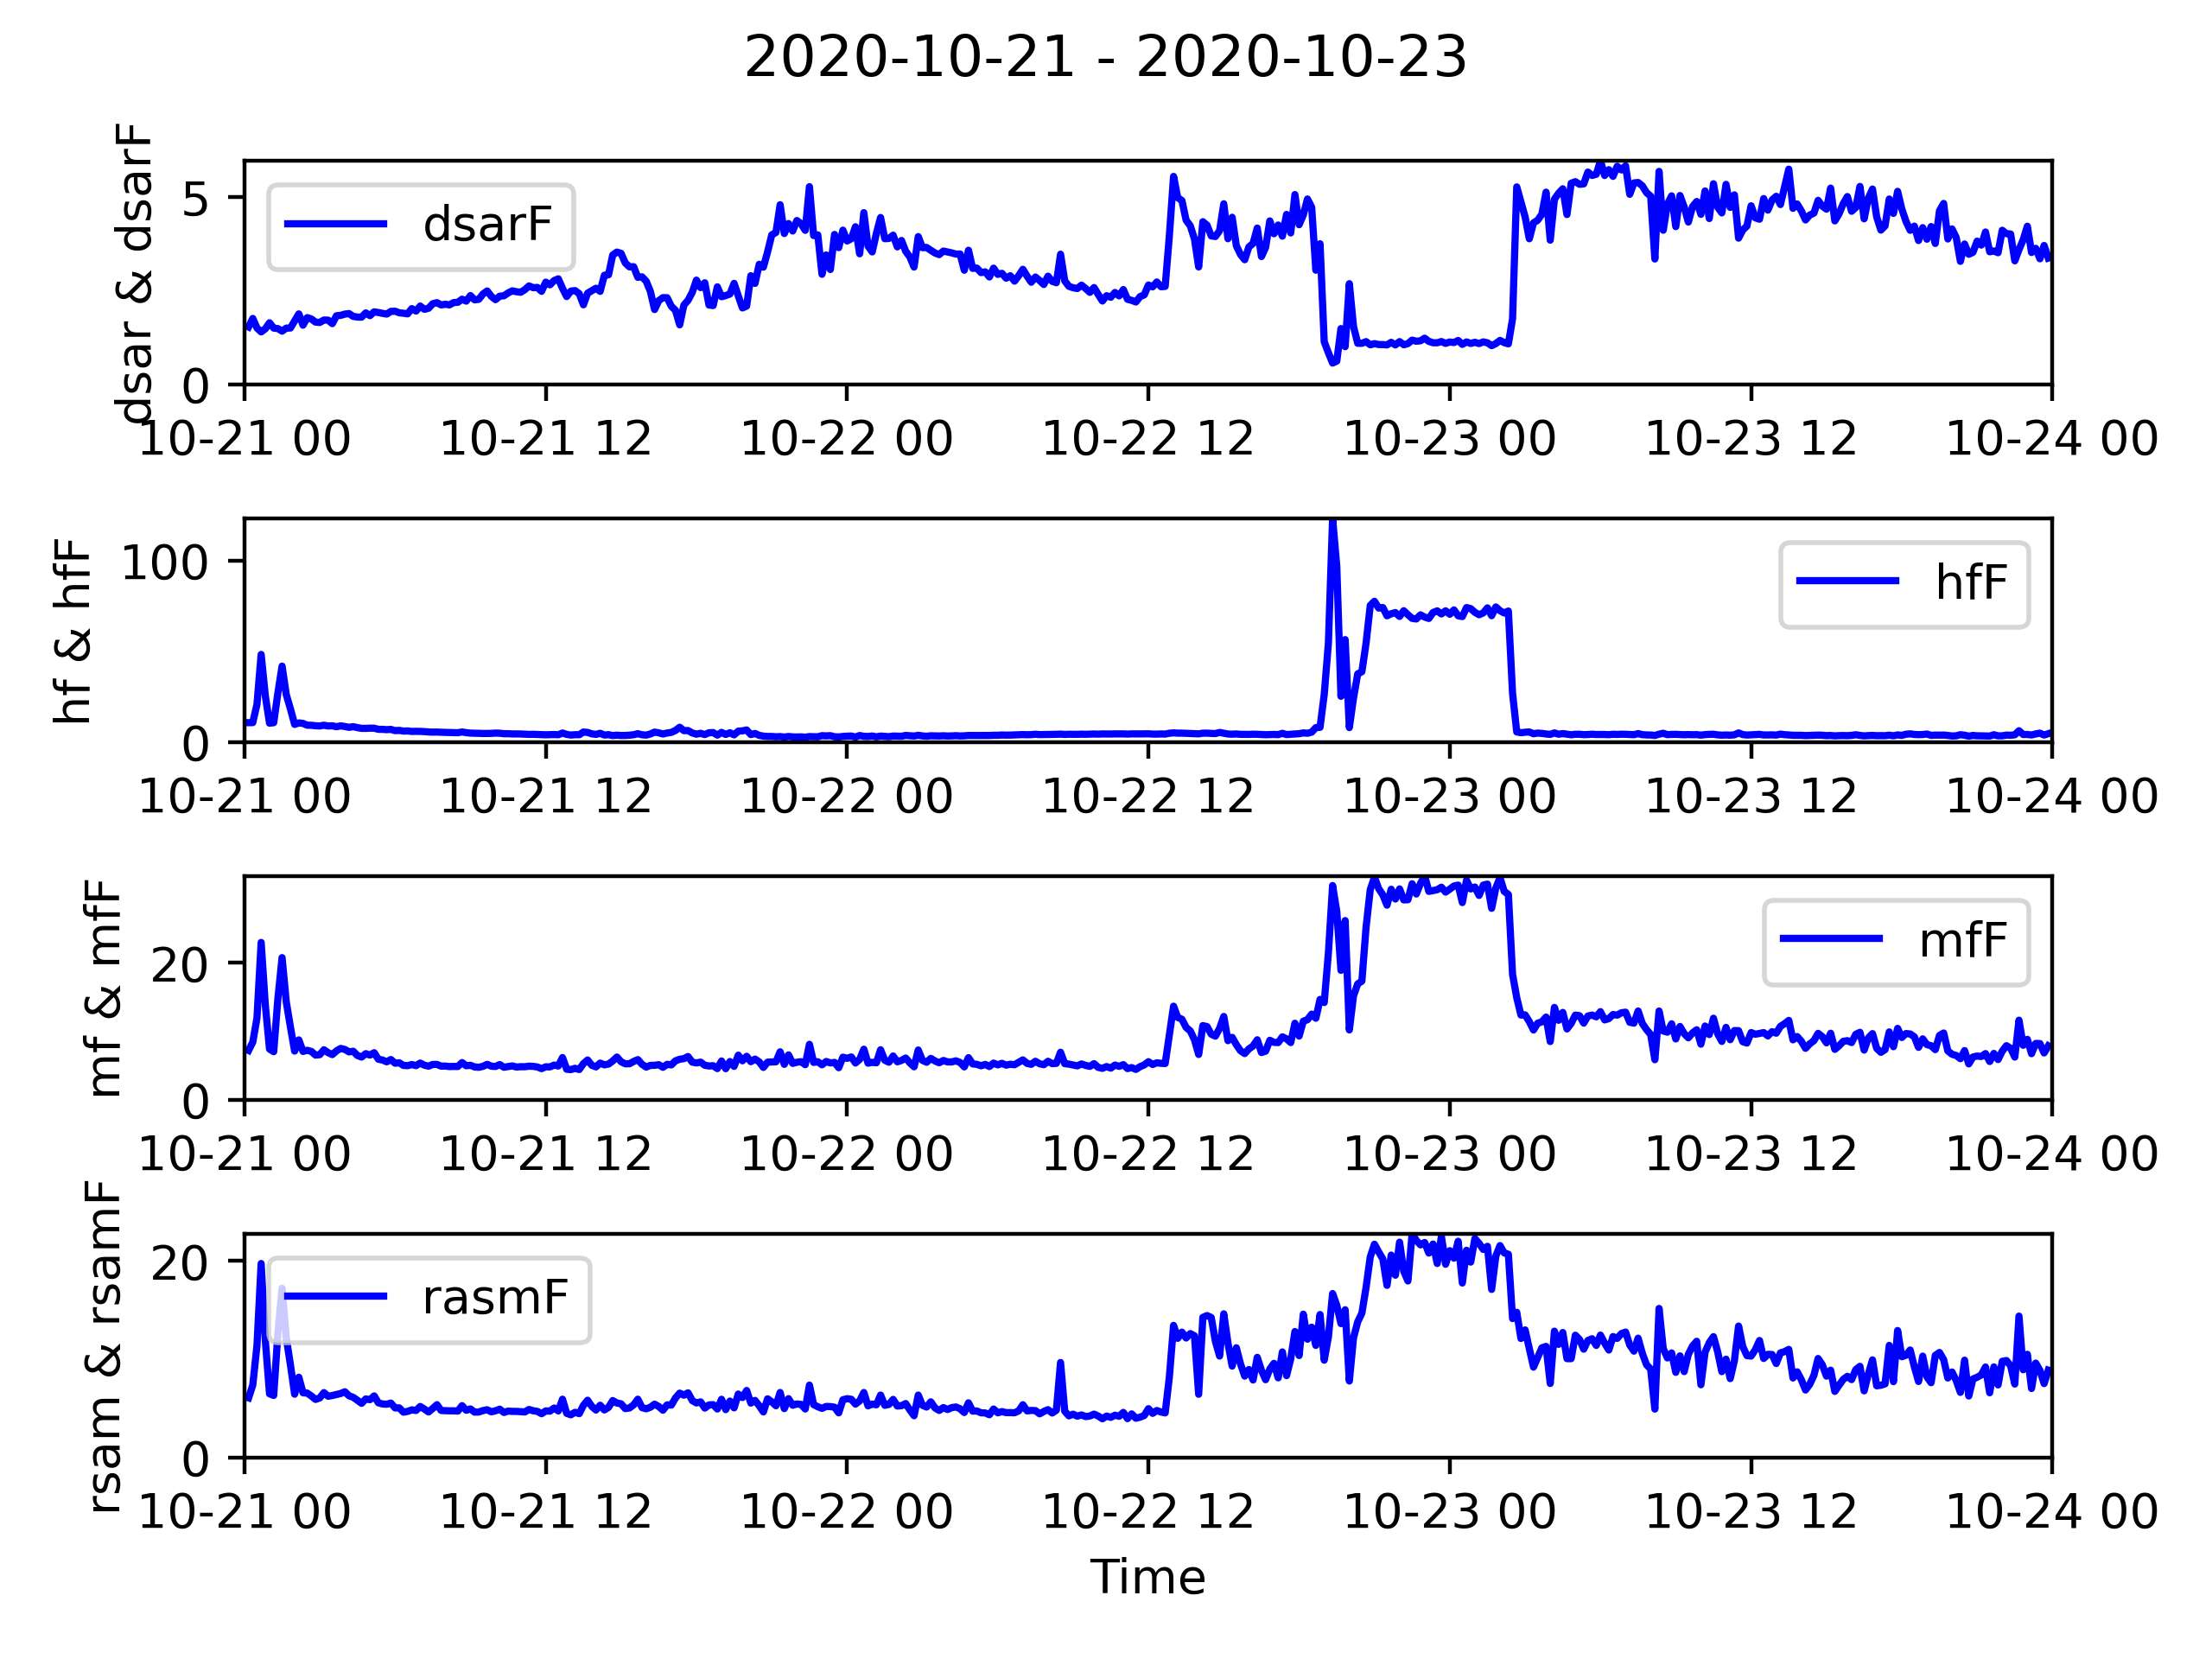
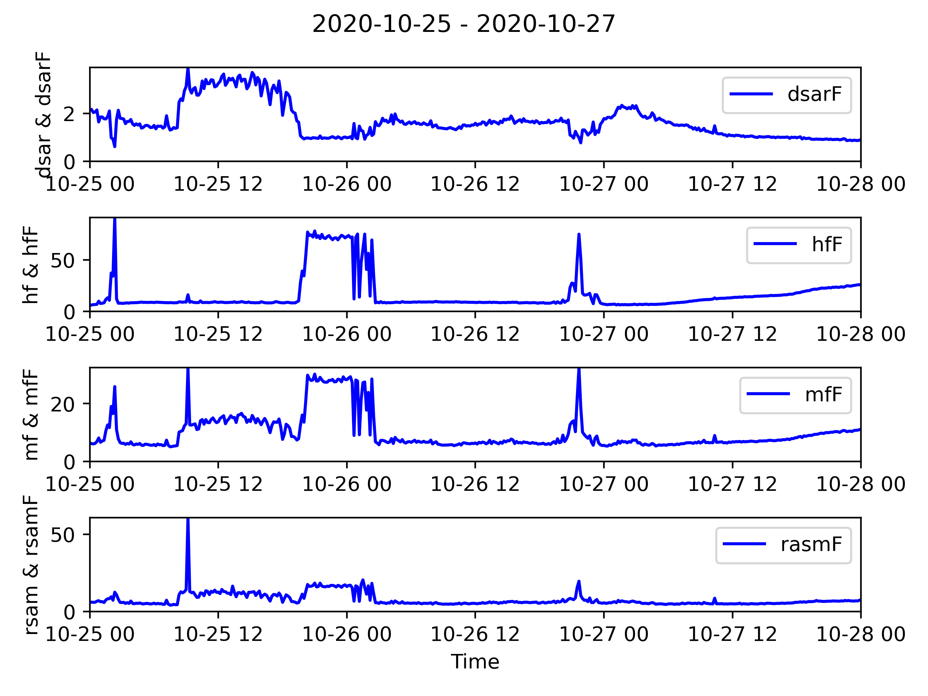
We searched the data for 20 examples of noise
Notes:
Will
Plan to adapt machine learning algorithm developed at Whakaari to classify the storm and chairlift noise.
20 examples of each type of noise were manually found
Show the model 15 of these examples to learn what typical time series features of storm/chairlifts look like.
Test the model if it can recognise the other 5 as storm or chairlift noises.
Find the examples of storm/chairlift noise. Divide into training and testing sets. Train a ML model on the training examples (uses time series features). Test the model on the unseen events + eruption
“706 features of the 48-h time series, e.g., mean and standard deviation, slope and standard error of a linear regressor, and Fourier coefficients”

Slide 11
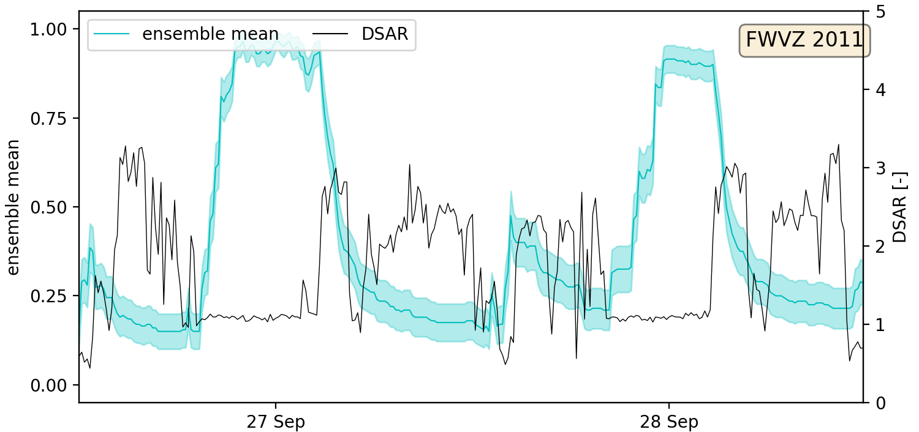
Model clearly identifies a test chairlift event
Notes:
Will
Describe plot generally. Blue line is output of model. Measure of certainty. -DSAR suppression is a visual signal to show when chairlift is operating
Chairlift periods, 8-hour, DSAR suppression.
Ensemble mean reaches 0.90 for the chairlift events.
Ensemble mean drops to 0.25 when no chairlift events.
Delay of the ensemble mean.

Slide 12
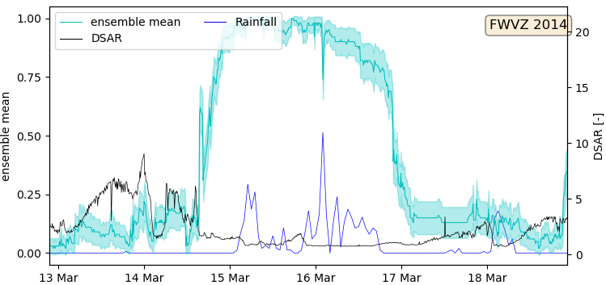
Similar performance identifying a test storm event
Notes:
Will
Key difference – rainfall included alongside DSAR for manual identification
Ensemble mean reaches 0.95 for the storm events.
Ensemble mean drops to 0.20 when no storm events.
Model indicated before rainfall begins (8-hour), wind also generates noise and rainfall measured at Chateau so it could rain at the station FWVZ before it rains at Chateau

Slide 13
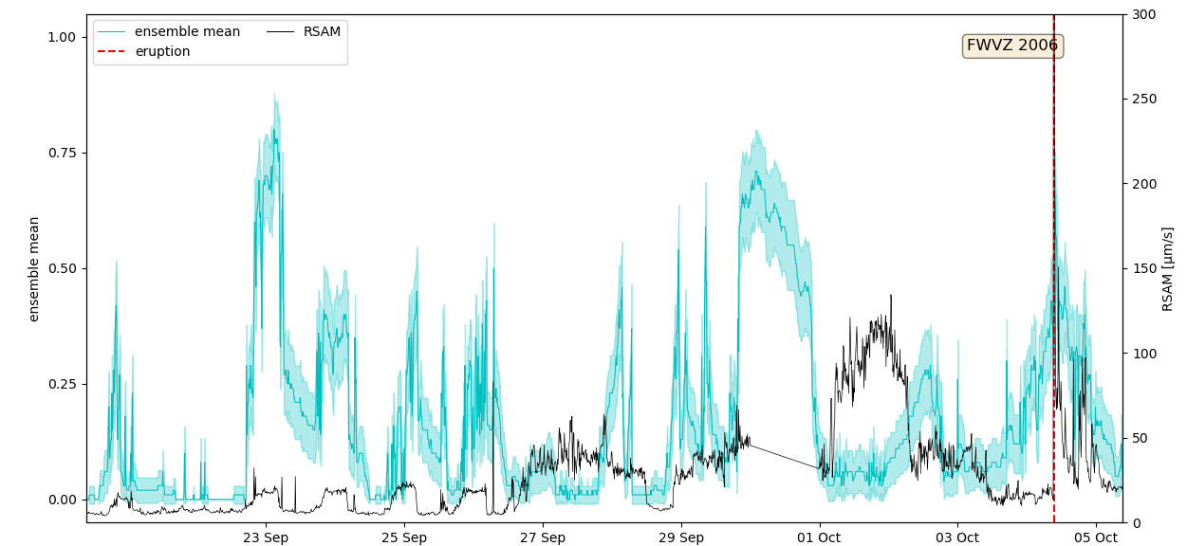
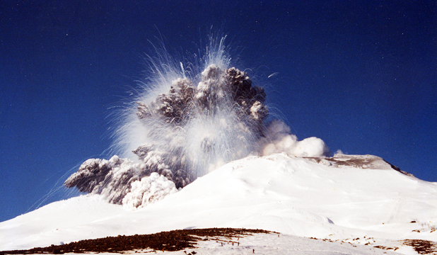
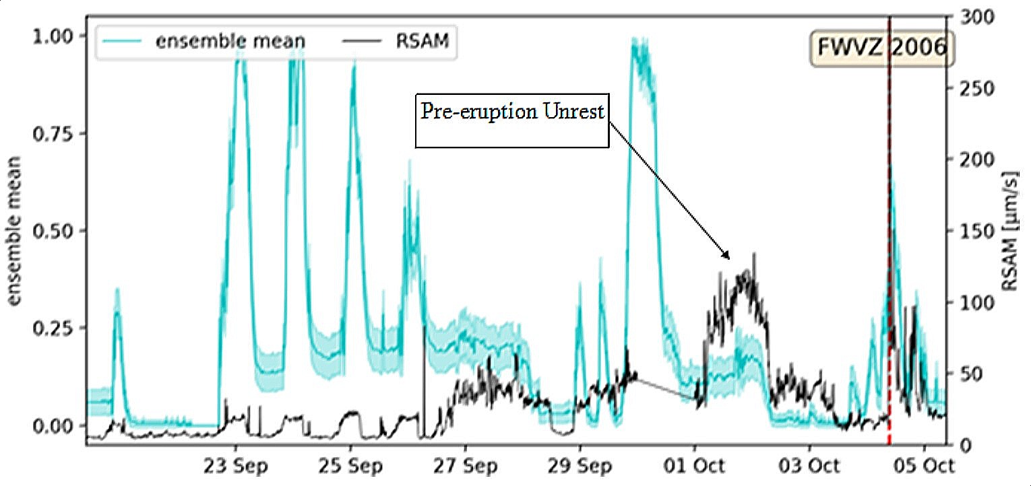
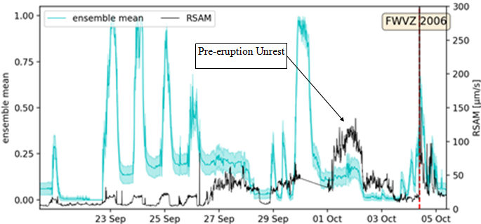
Models do not falsely classify pre-eruption unrest
Storm one for emergency use. Doesn’t show exactly what we want it to so chairlift one is better
Notes:
Tom
Also important that
The purpose of classification
This is chairlift model – see successful classification earlier
Neither models identify the unrest as a storm or chairlift event for any eruptions we have data for

Slide 14
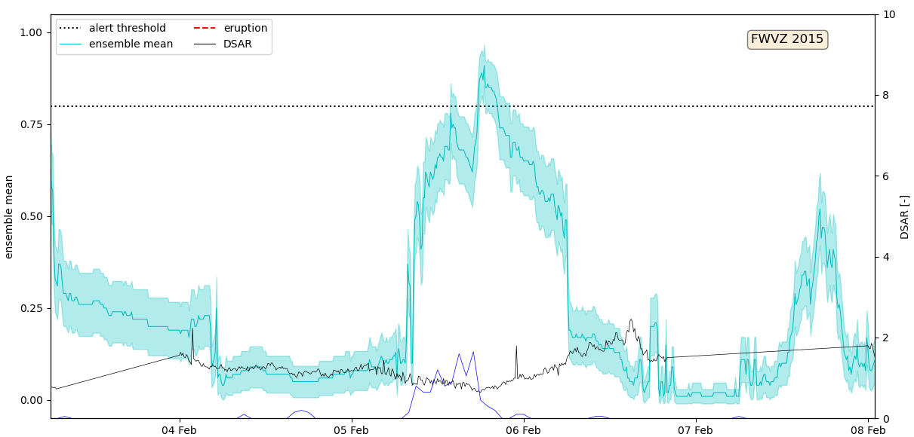
Implementation in an automated forecaster requires a defined threshold for identification
Notes:
Tom
What is a threshold going to mean
High and low thresholds
How threshold leads to data in an eruption forecaster

Slide 15
It was shown that storm and chairlift noise on Ruapehu could be classified.
Classification certainty from 85% to 95%.
Does not falsely classify pre-eruption unrest.
Has potential to improve an automated eruption forecaster at Ruapehu.
Thank you. Any questions?
Notes:
Tom
Surface noise can be classified
85 – 95%
Doesn’t falsely classify
Has potential – Ruapehu and beyond
Thank you

